Slide 1
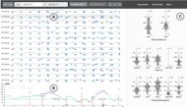
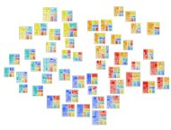
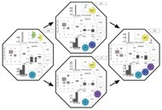

EHR STAR:
The State-Of-the-Art in Interactive EHR¹ Visualization
Qiru Wang and Robert S Laramee
School of Computer Science
University of Nottingham, UK
Interested in Collaborating?
¹Electronic Health Records

Slide 2
Introduction and Motivation
There are several recent initiatives aimed at improving collective health using a data-centric approach.
An executive order by U.S. president in 2004 [Bus04]
The SAIL Databank [FJV*09]
Horizon 2020 initiative [Lar14, Eur17]
Many other data-centric initiatives
It is widely believed and accepted that a nation’s health can be improved through collection and analysis of Electronic Health Records (EHRs)
Notes:
Table 1 first half

Slide 3
EHR STAR Contributions
The contributions of the EHR STAR include
An up-to-date overview of EHR Visualization literature: 200+ related references, 19 tables
Novel classifications of the literature based on reoccurring themes and the Unified Medical Language System (UMLS)
A survey of open access health data sources
An overview of future challenges and unsolved problems in the field
An interactive EHR literature and data browser, https://ehr.wangqiru.com/
Notes:
Table 1 first half

Slide 4
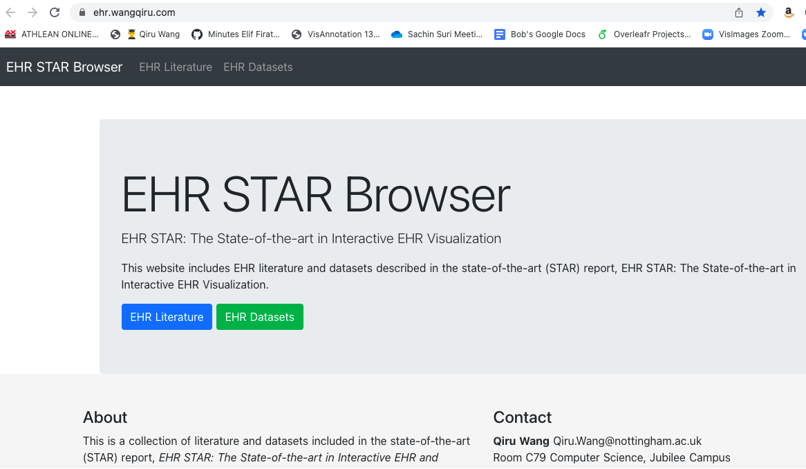
EHR STAR Browser
Notes:
Table 1 first half

Slide 5

EHR STAR Literature Overview
Challenges in the Field
Literature Search Methodology
Terminology
Literature Classifications
Related Work
Visualization of EHR Data
  Machine Learning
  Natural Language Processing
  Event Sequence Simplification
  Visual Analytics and Comparison
  Visual Analytics and Clustering and Others
  Population HR and Geospatial Visualization
Evaluation Techniques
Notes:
Table 1 first half

Slide 6

Part 2: EHR STAR Health Data Overview
Open Access Health Data
Health Data Challenges
Health Data Search Methodology
Health Data Scope
Health Data Sources Classification
Not possible to cover all details in presentation.
Notes:
Table 1 first half

Slide 7
Challenges in EHR Visualization
Diverse Literature Sources
Multidisciplinary Research Themes
Inconsistent Terminology
Health Data Challenges
Acquisition
Data Protection
Data Heterogeneity
Scalability
High-dimensionality
Notes:
Table 1 first half

Slide 8
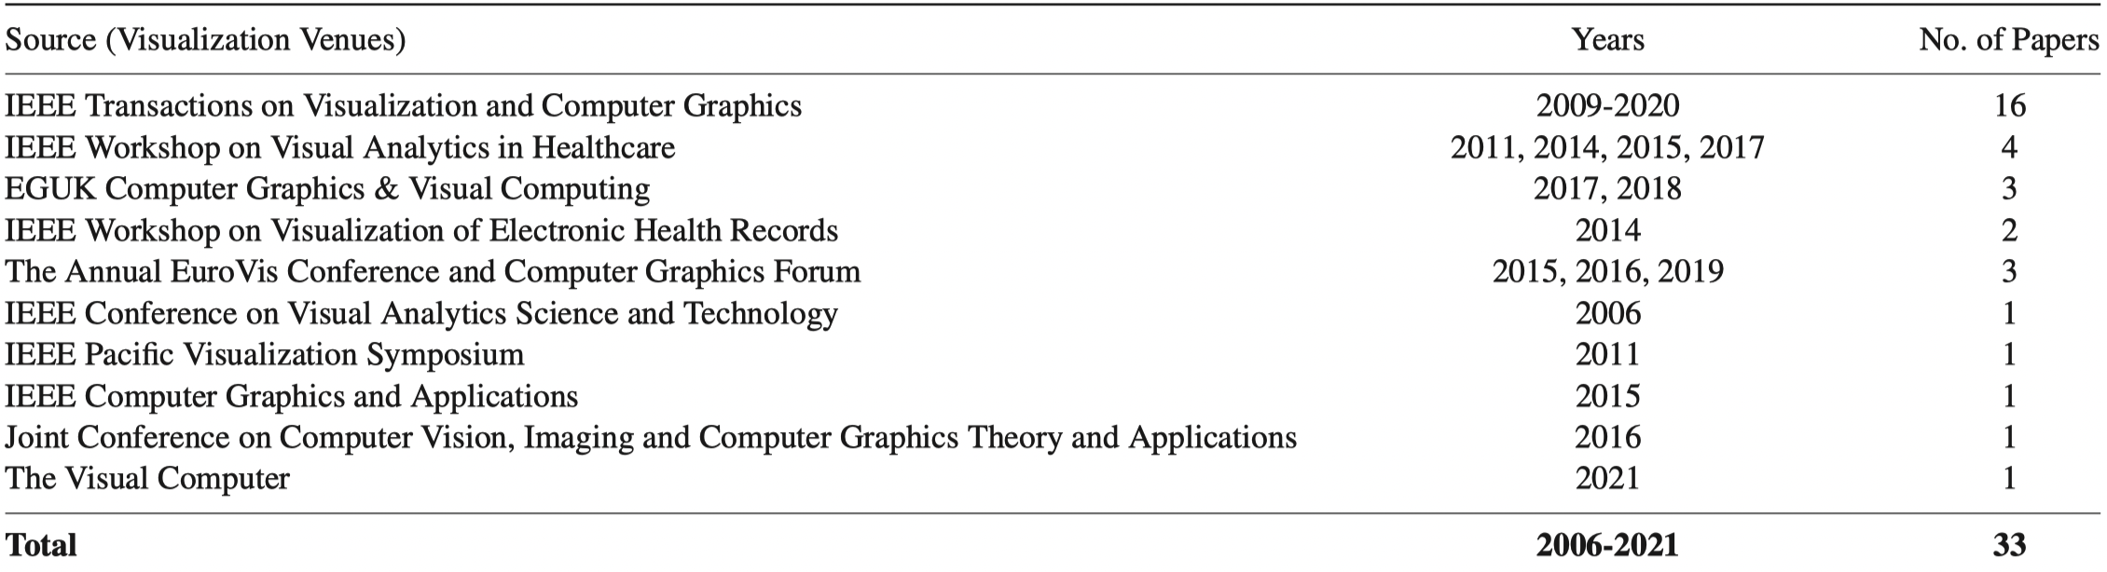
Visualization Literature Search Part 1:
Vis Conferences and Journals
Notes:
Table 1 first half

Slide 9
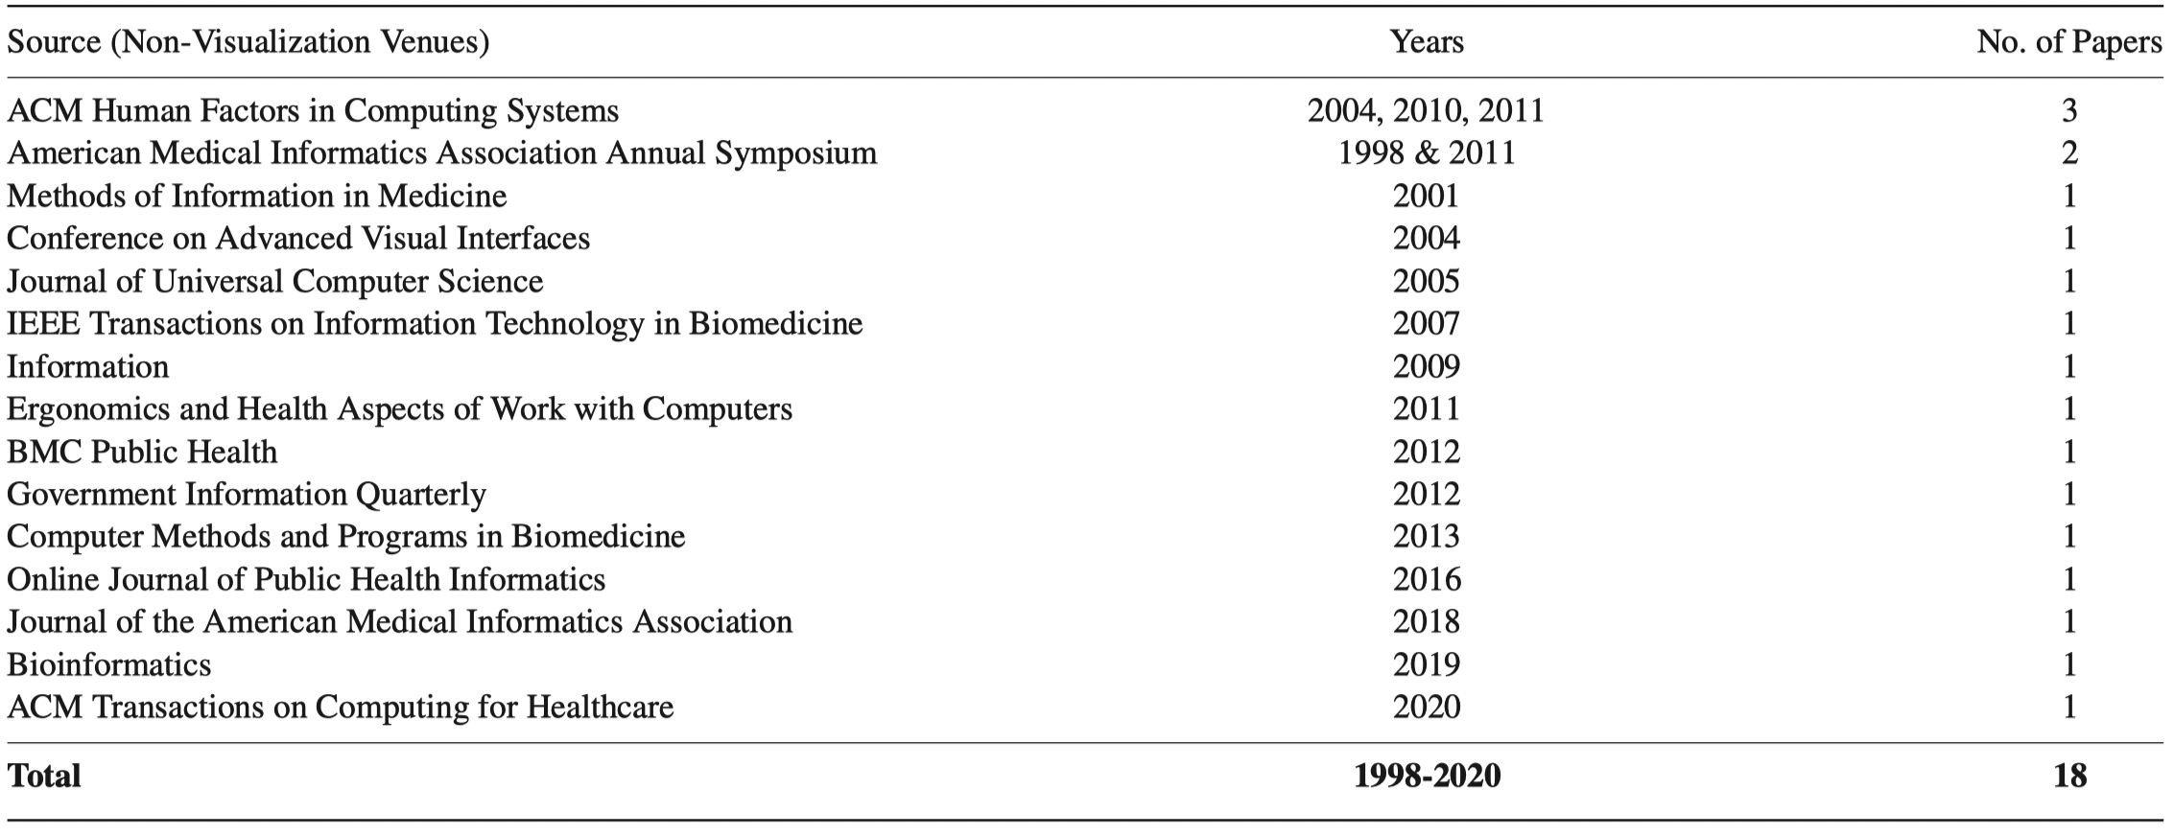
Visualization Literature Search Part 2:
Non-Vis Conferences and Journals
Notes:
Table 1 second half

Slide 10
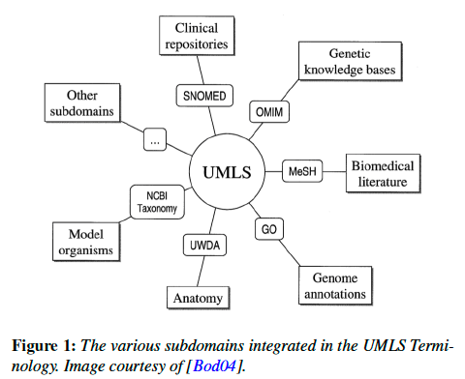
Terminology
Various terms used throughout literature.
No standard definition of EHR
EHR (Electronic Health Record): longitudinal collection of comprehensive patient medical information in machine readable formats, maintained and shared by healthcare providers, and stored securely in an electronic system.
EMR (Electronic Medical Record): EHR used internally only
PHR (Personal Health Record): Managed by data owner, i.e., the individual, shared only when authorized.
PopHR (Population Health Record): Same as EHR but defined on a given population
UMLS (Unified Medical Language System): A standardized list (2.5 million) of medical concepts, terms with unique IDs.
Notes:
Table 1 second half

Slide 11
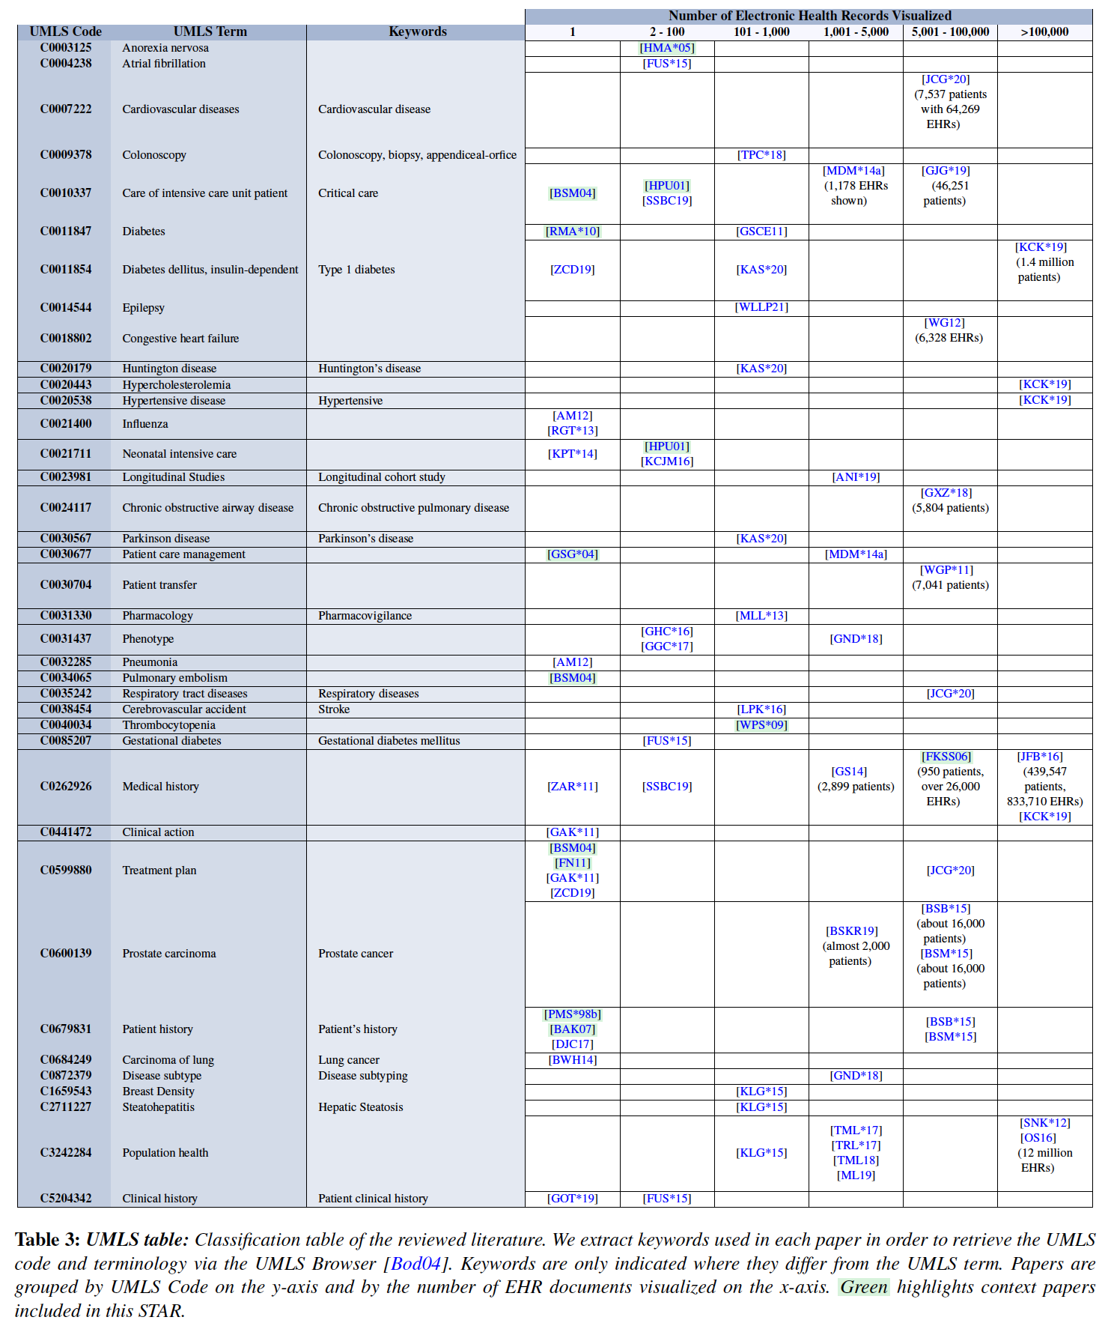
Literature Classification by UMLS Terms
Notes:
Table 1 second half

Slide 12
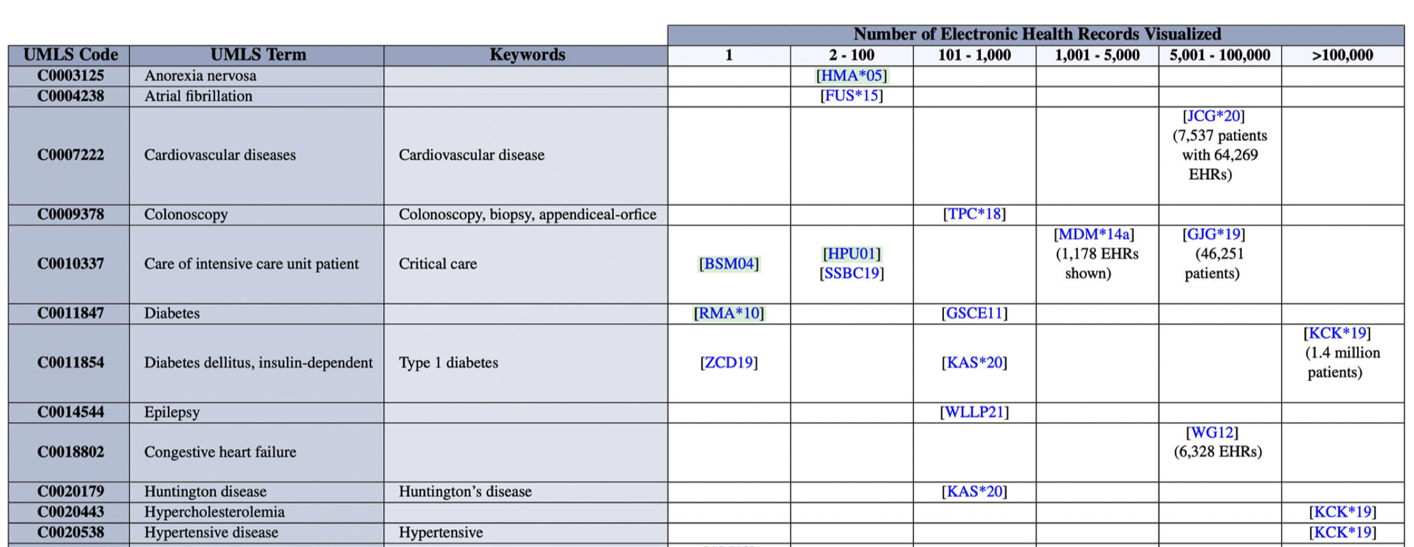
Literature Classification by UMLS Terms
Notes:
Table 1 second half

Slide 13
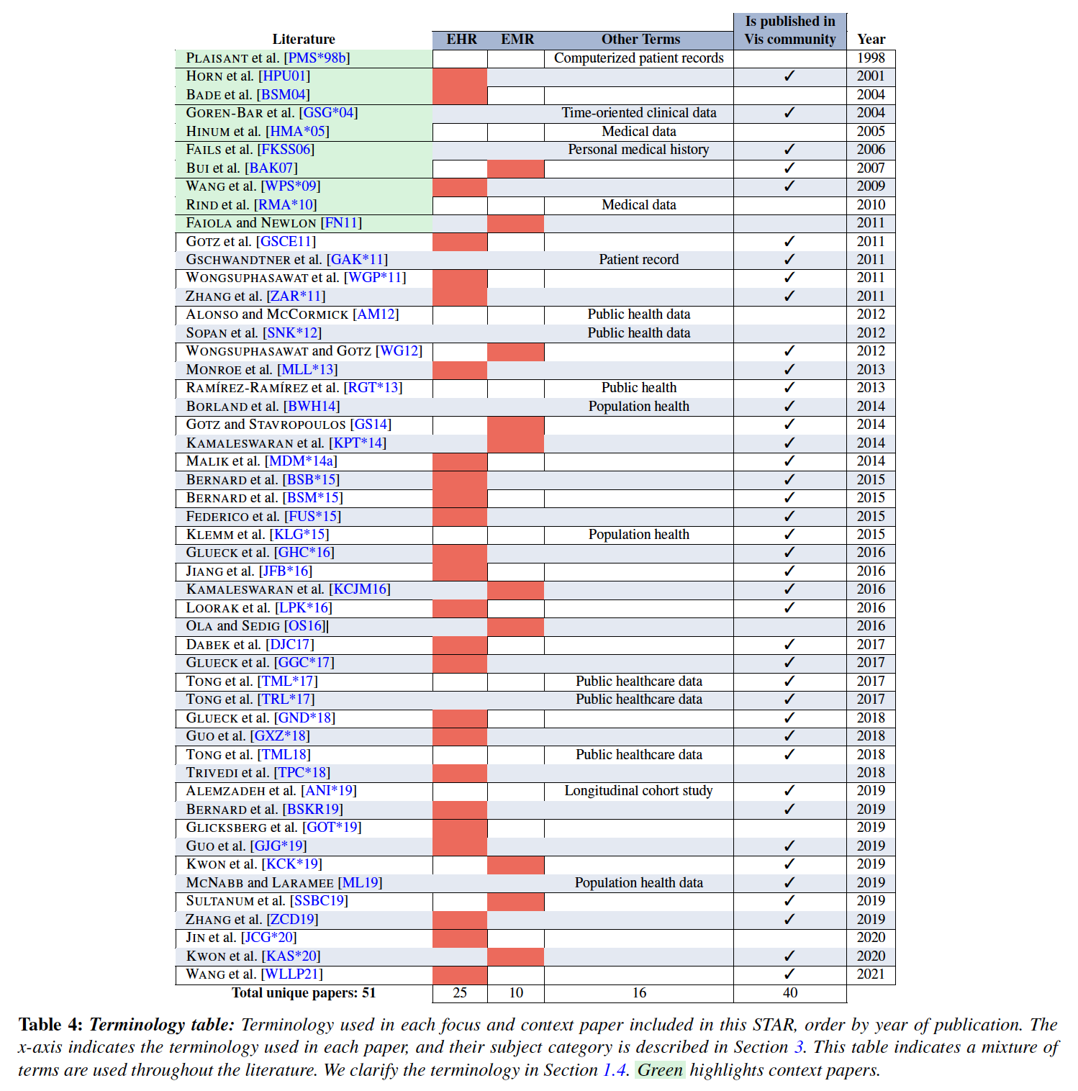
Literature Classification by Definitions Used in Paper
Notes:
Table 4, top rows, EHR, EMR, and Others

Slide 14
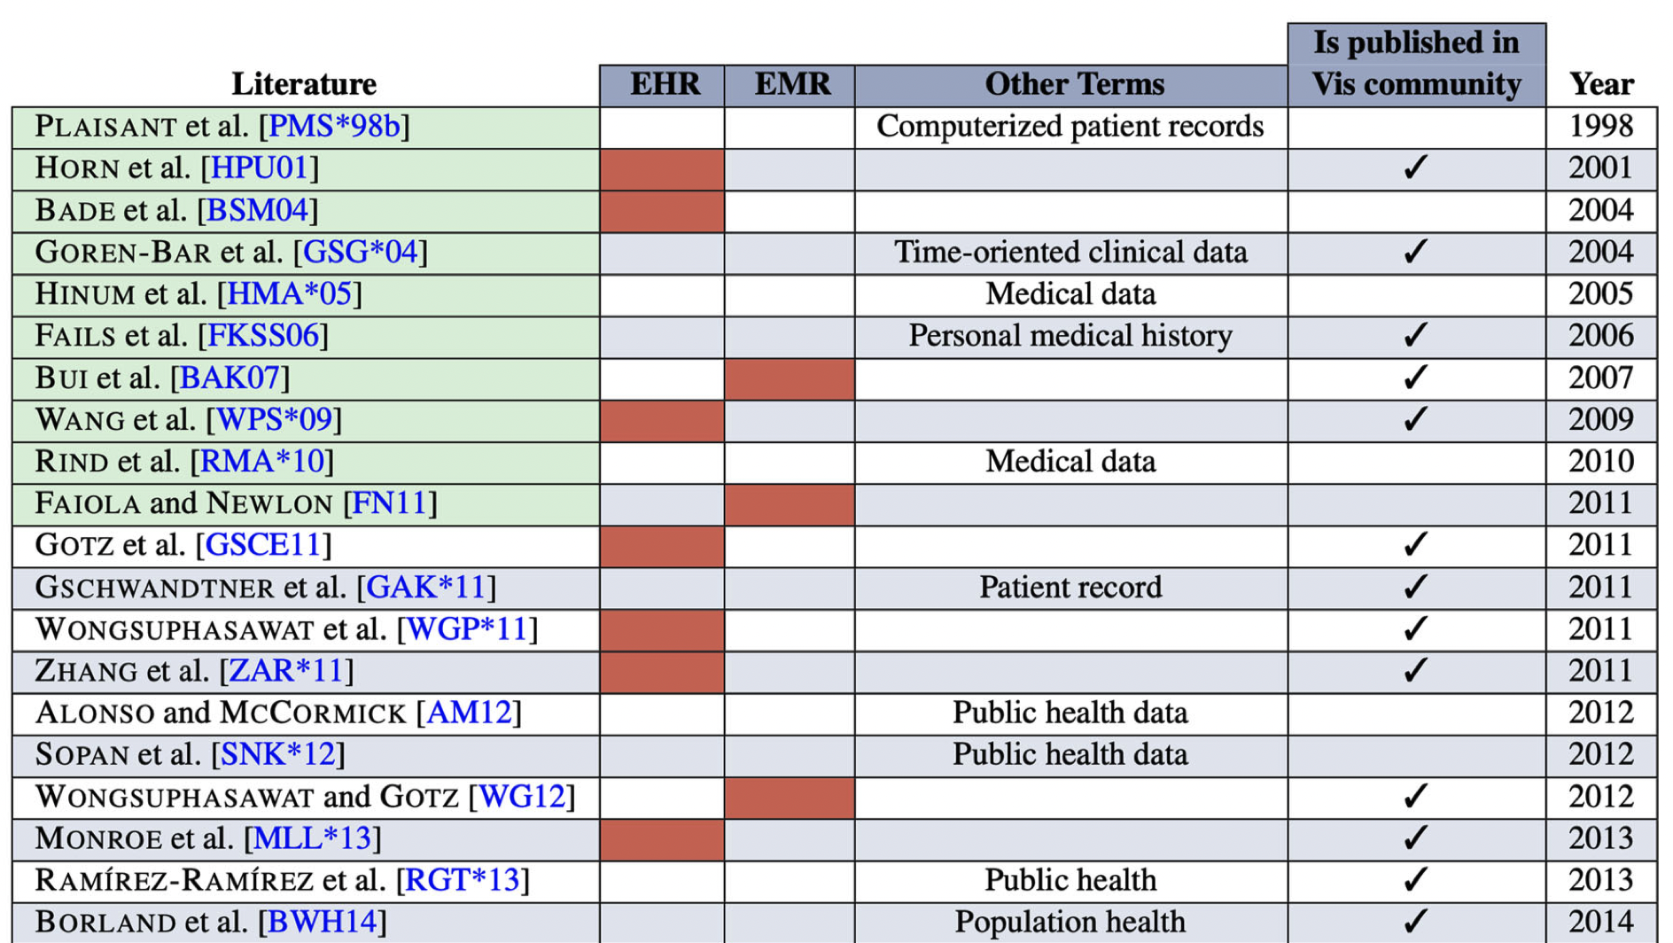
Classification by Definitions Used in Paper
Notes:
Table 4, top rows, EHR, EMR, and Others

Slide 15
EHR STAR Literature Overview
Challenges in the Field
Literature Search Methodology
Terminology
Literature Classifications
Related Work
Visualization of EHR Data
  Machine Learning
  Natural Language Processing
  Event Sequence Simplification
  Visual Analytics and Comparison
  Visual Analytics and Clustering and Others
  Population HR and Geospatial Visualization
Evaluation Techniques
Notes:
Table 1 first half

Slide 16
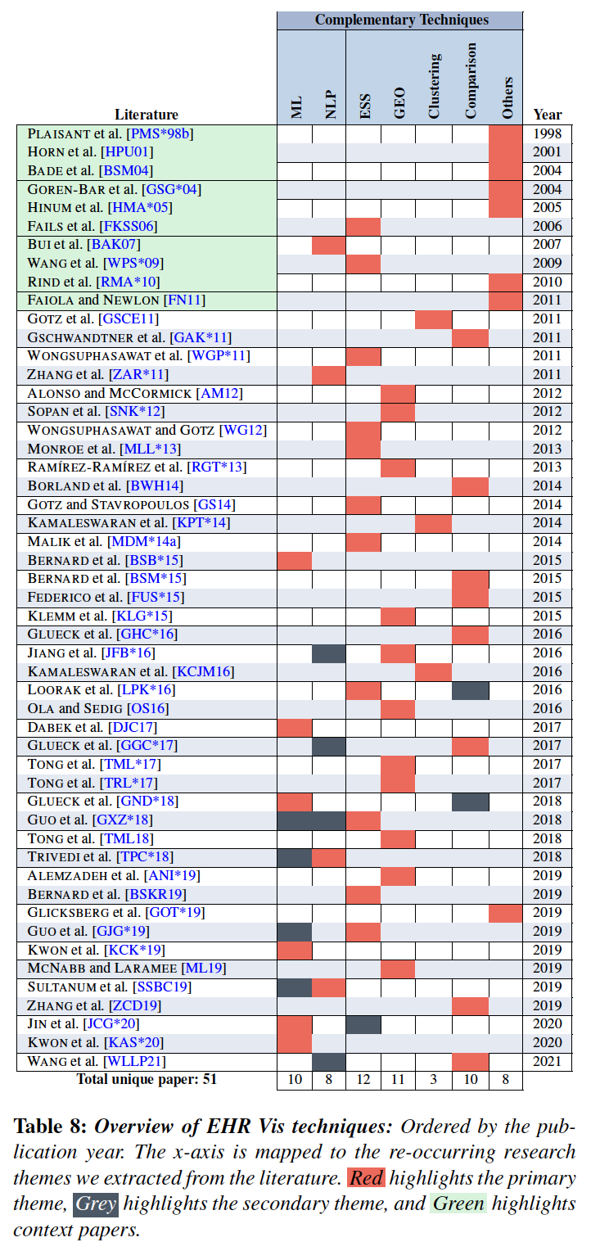
Literature Classification Based on EHR Visualization Techniques
Notes:
Table 8, top rows, overview of EHR Vis complementary techniques

Slide 17
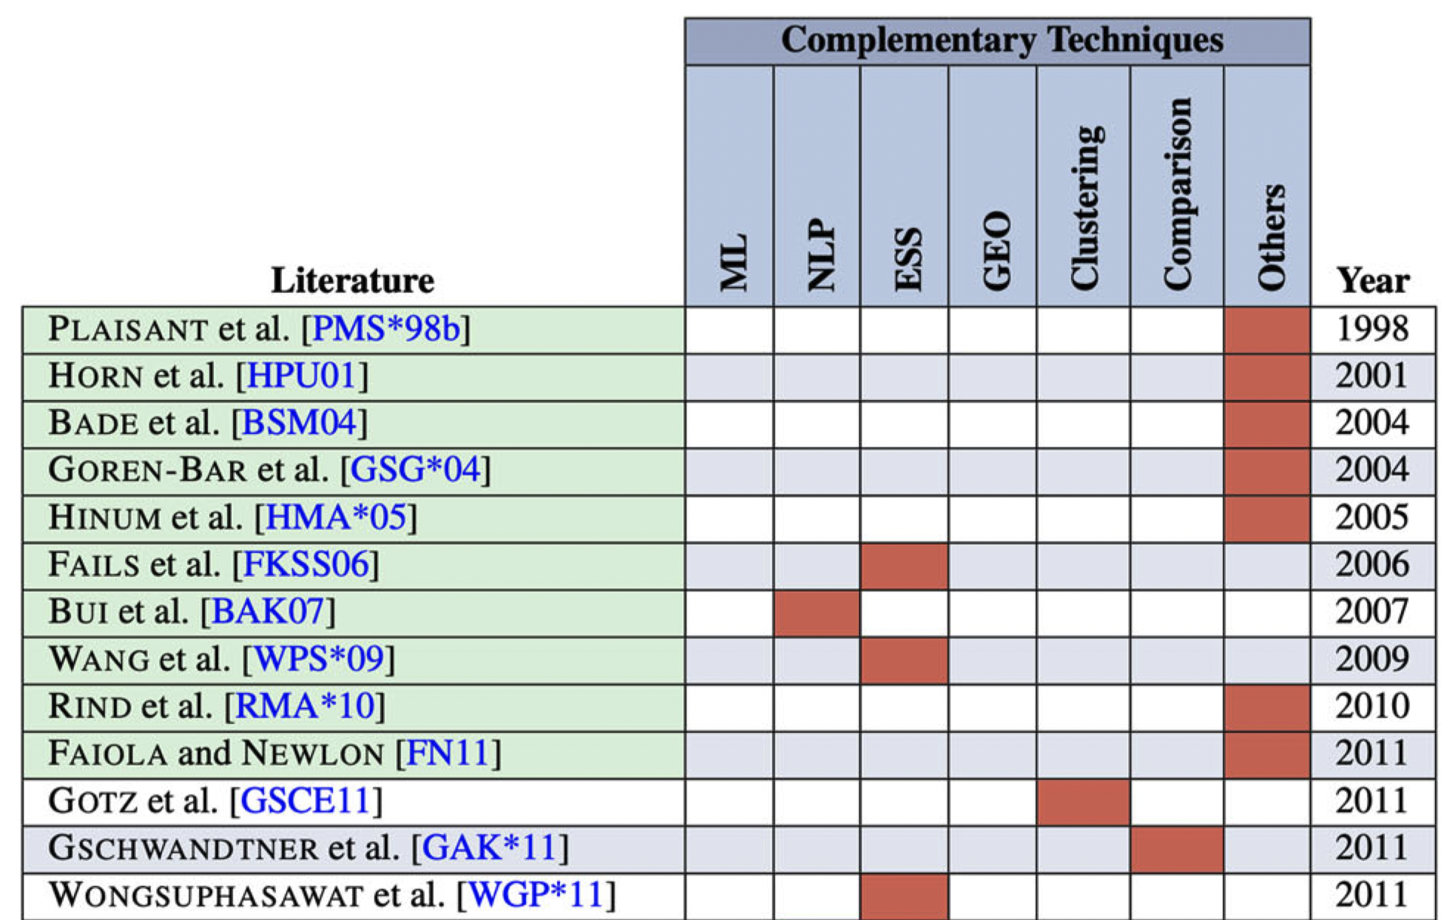
Literature Classification Based on EHR Vis Techniques
Notes:
Table 8, top rows, overview of EHR Vis complementary techniques

Slide 18
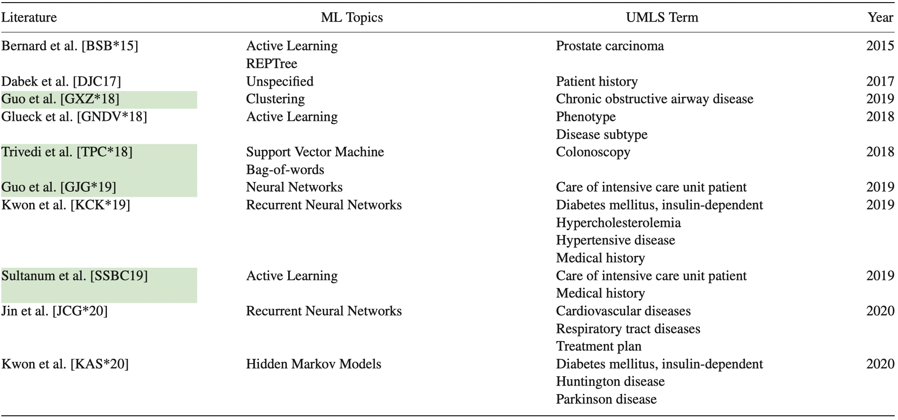
EHR Visualization: Machine Learning
Green indicates ML as a secondary theme.

Slide 19
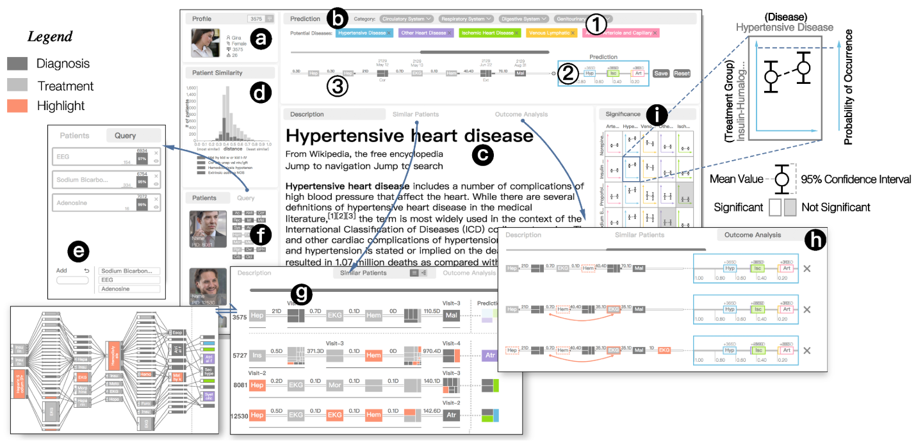
Machine Learning Example
CarePre by Jin et al [JCG*20]
Converts EHR data from a patient cohort into event sequences
Uses machine learning (recurrent neural networks) for predicting a patient’s risk level
Then recommends most influential treatment plans
MIMIC data set is used [JPS*16]
Cardiovascular disease
Notes:
Table 9, machine learning papers

Slide 20
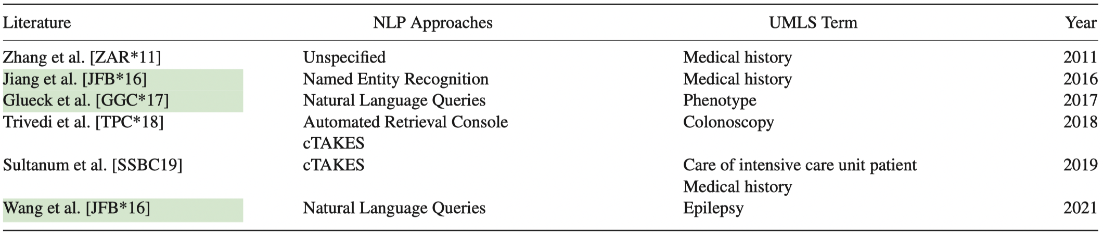
EHR Visualization:
Natural Language Processing
Green indicates NLP as a secondary theme.

Slide 21
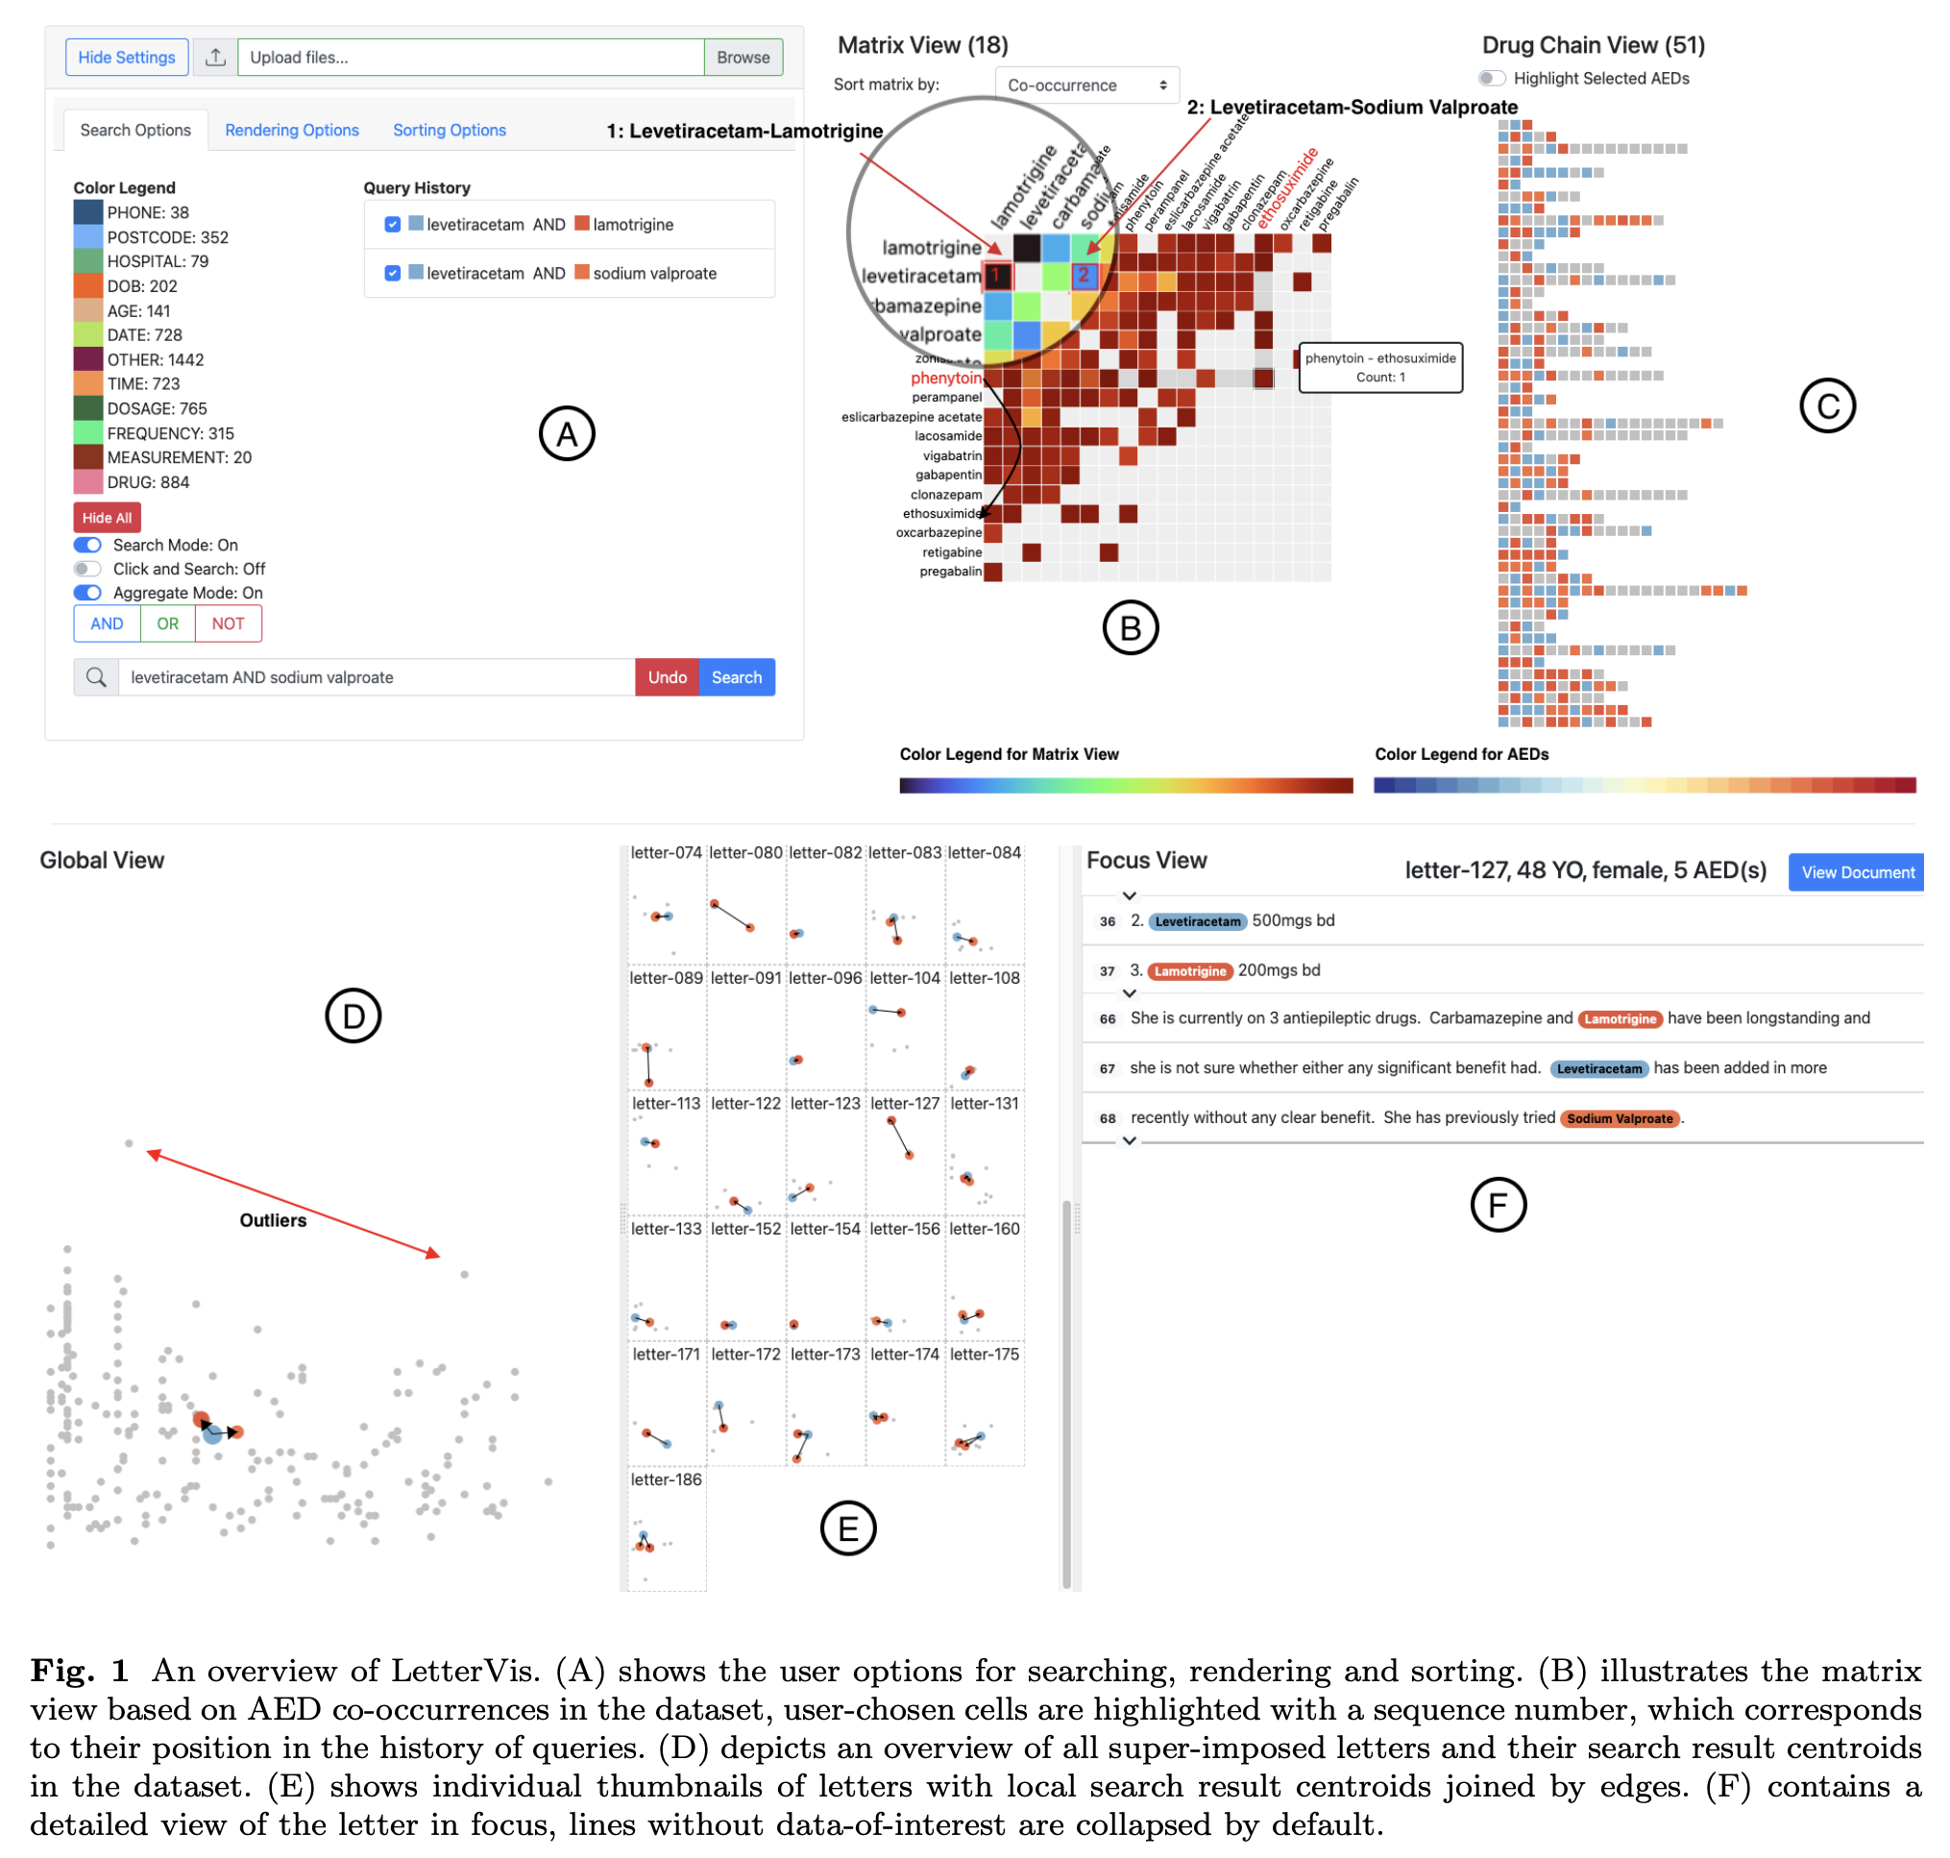
Natural Language Processing Example
LetterVis by Wang et al [WLL*2022]
Extracts metadata from a collection of doctors letters
Compares location of metadata in clinic letters: Global + Thumbnail views
Looks for common and unusual drug patterns
Notes:
Table 9, machine learning papers

Slide 22
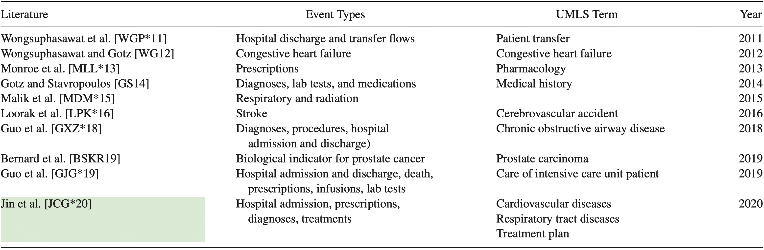
EHR Visualization:
Event Sequence Simplification (ESS)
Green indicates ESS as a secondary theme.

Slide 23
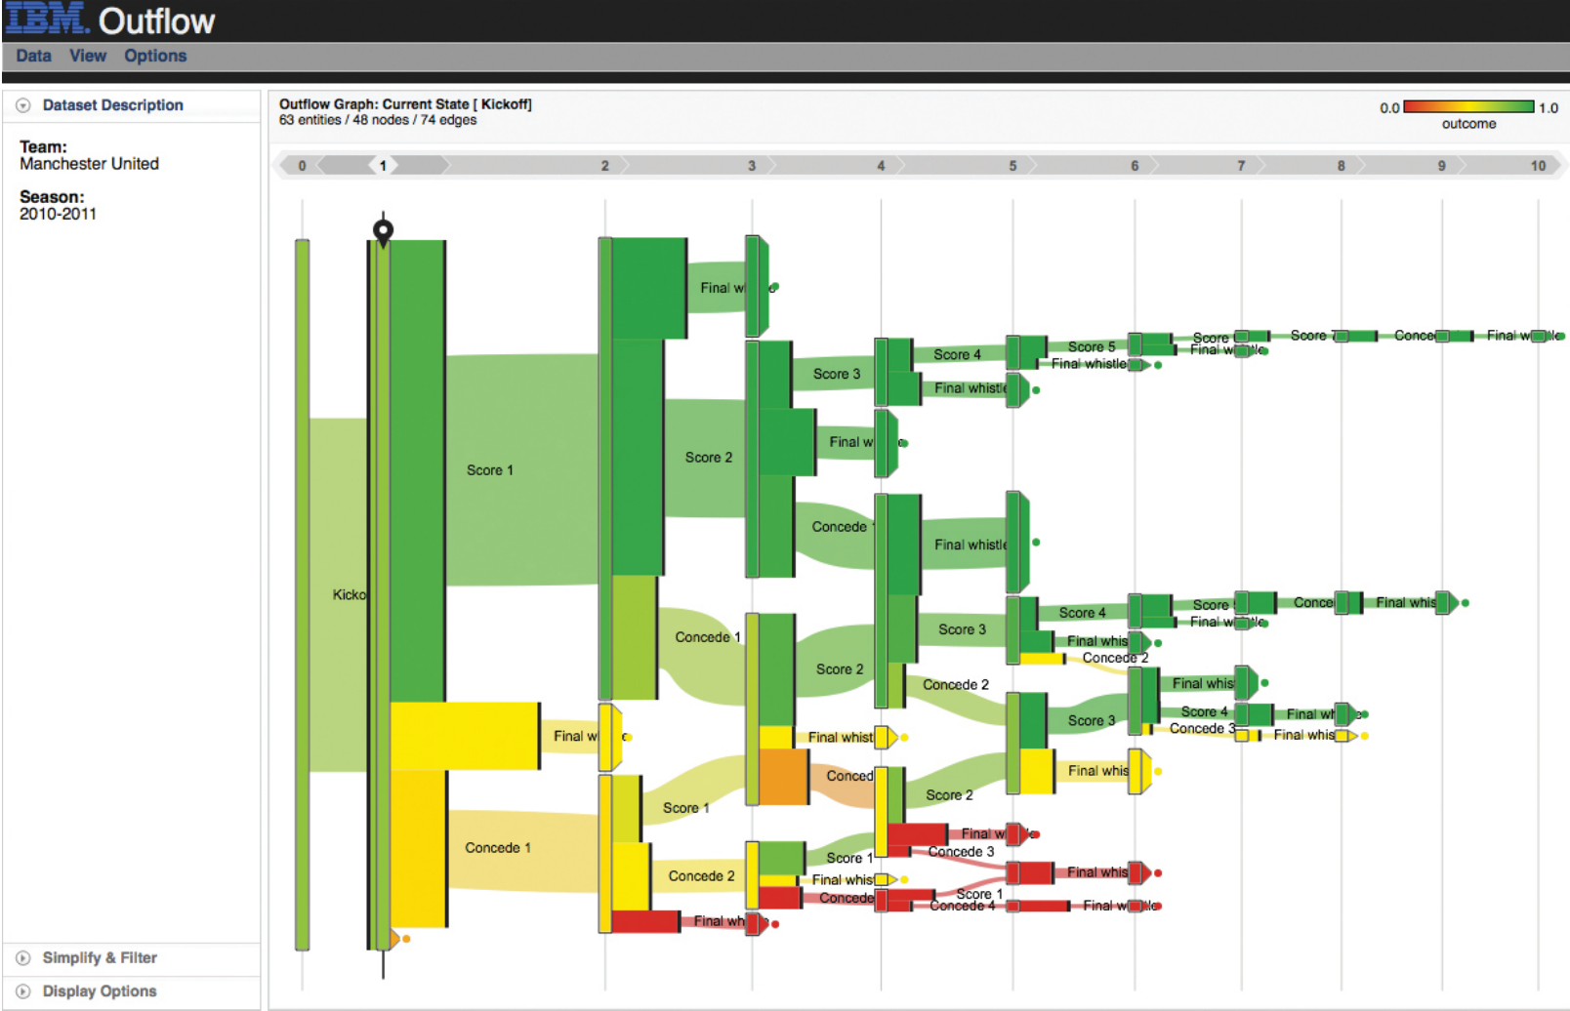
Event Sequence Simplification Example
Outflow by Wongsuphasawat et al [WG2012]
Visualization of temporal event sequence data
Depicts aggregated events using a graph
Simplifies comparison of alternative paths
Supported by a user-study
Applied to hear failure
Notes:
Table 9, machine learning papers

Slide 24
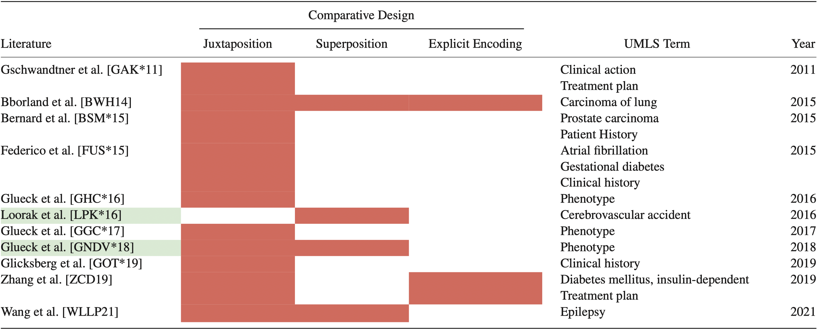
EHR Visualization:
Visual Analytics and Comparison

Slide 25
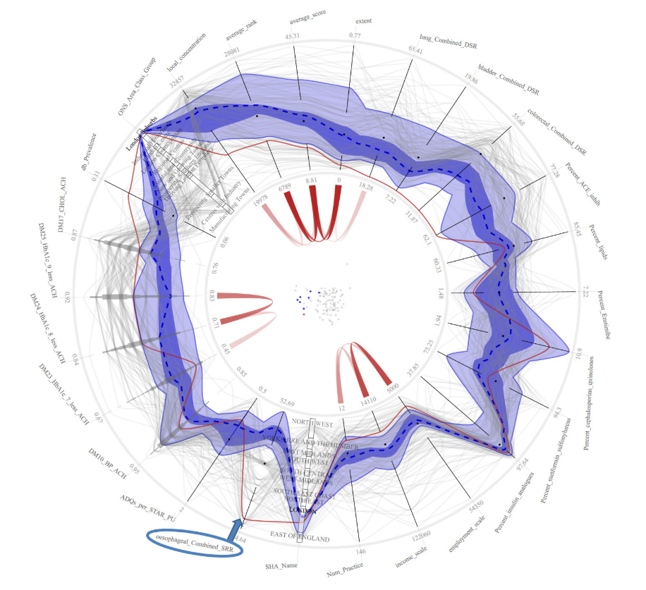
Visual Analytics and Comparison Example
Radial Cooridnates by Borland et al [BHW14]
Parallel Coords + Scatterplot + Chord diagram
Each variate mapped to an axis
Chords represent relationships between variates
Supports comparison of high and low prevalence values
Applied to NHS data
Notes:
Table 9, machine learning papers

Slide 26
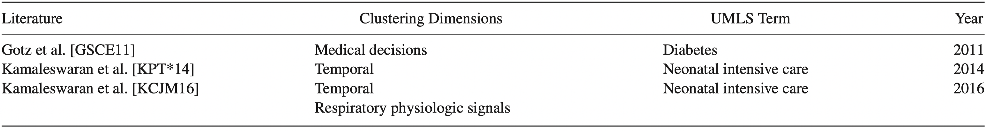
Visual Analytics with Clustering and Others

Slide 27
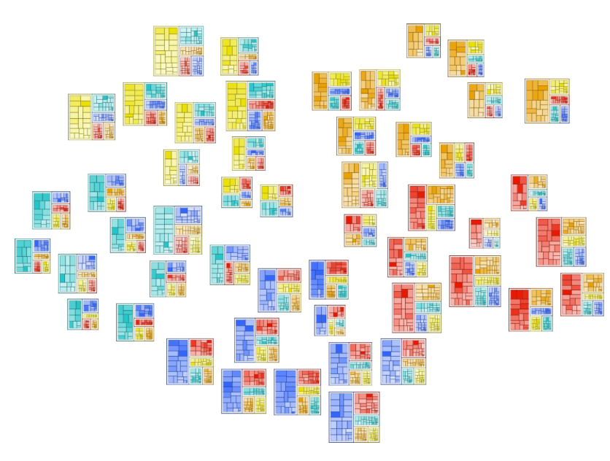
Visual Analytics and Clustering Example
DICON by Gotz et al [GSCE11]
Exploration of Cohort Similarity
Each cluster is represented by a dynamic icon
Cluster refinement guided by user
User may drag, drop, merge, split clusters and refine clustering parameters
Applied to Diabetes
Notes:
Table 9, machine learning papers

Slide 28
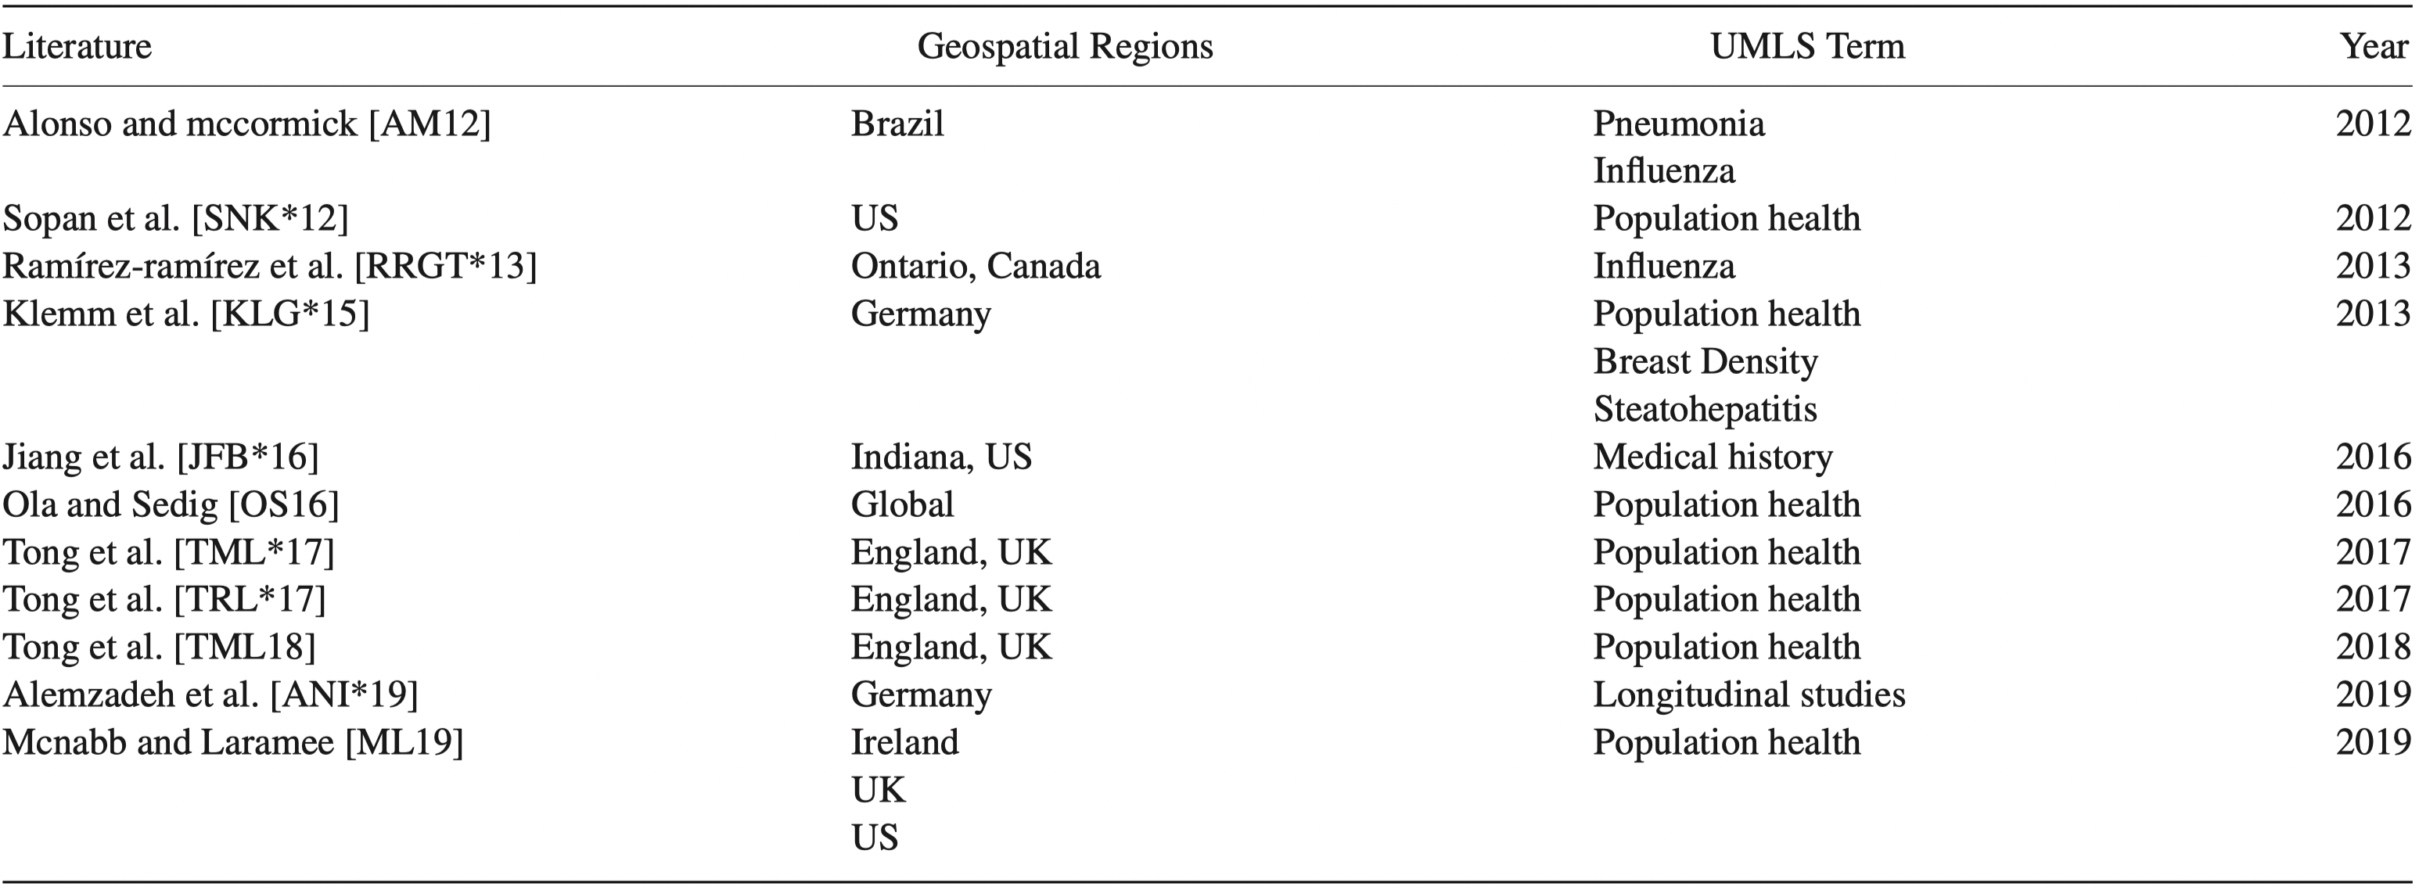
PopHR VIS and Geospatial Visualization

Slide 29
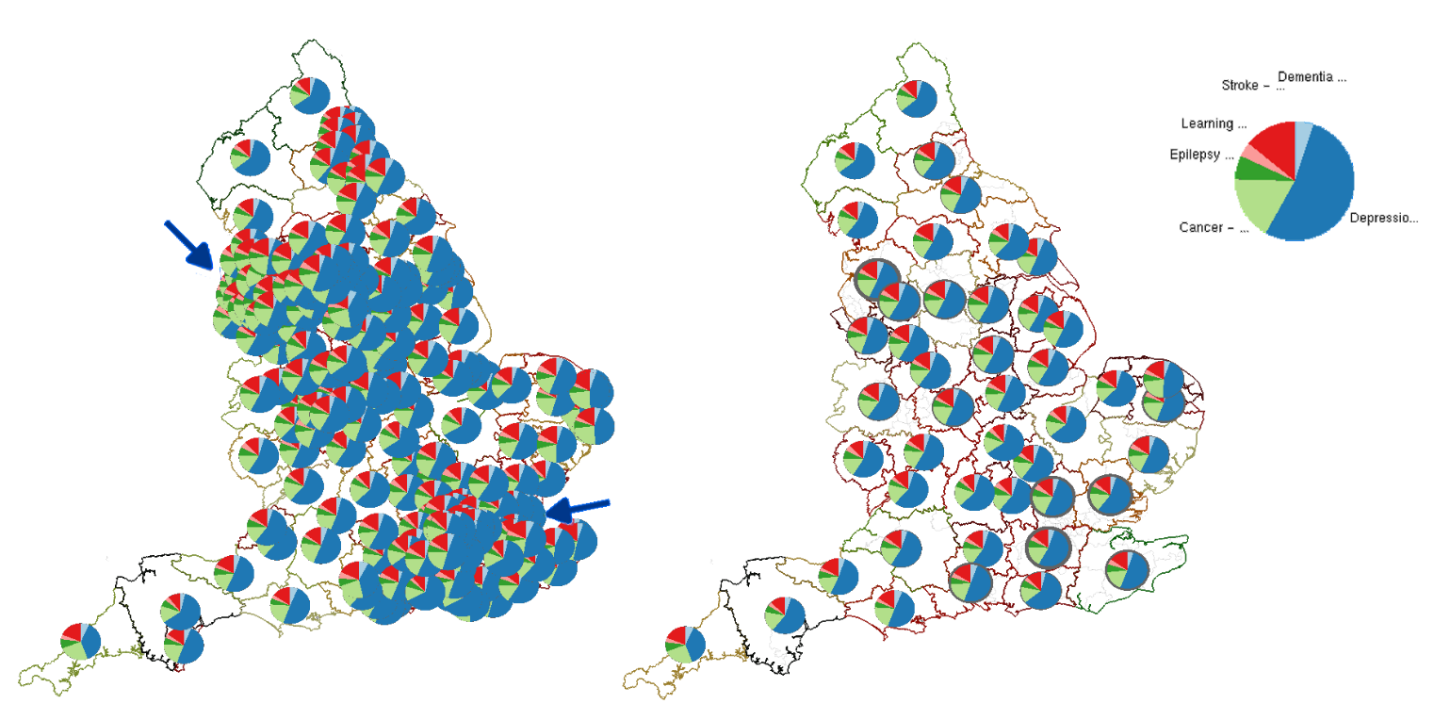
Population HR Example
Multivariate Maps by McNabb and Laramee [ML19]
Multivariate Glyph Placement Algorithm
Applied on choropleths
Cluster Glyphs are dynamic based on zoom level of choropleth
Applied to high-dimensional Public Health England data
Notes:
Table 9, machine learning papers

Slide 30
EHR STAR Literature Overview
Challenges in the Field
Literature Search Methodology
Terminology
Literature Classifications
Related Work
Visualization of EHR Data
  Machine Learning
  Natural Language Processing
  Event Sequence Simplification
  Visual Analytics and Comparison
  Visual Analytics and Clustering and Others
  Population HR and Geospatial Visualization
Evaluation Techniques
Notes:
Table 1 first half

Slide 31
Evaluation Techniques Used in Literature
Domain Expert Feedback (30 papers, 59%)
Interview (26 papers, 51%)
Case Study (17 papers, 33%)
Controlled User Study (8 papers, 16%)

Slide 32
Part 2: EHR STAR Health Data Overview
Open Access Health Data
Health Data Challenges
Health Data Search Methodology
Health Data Scope
Health Data Sources Classification
Not possible to cover all details in presentation.
Notes:
Table 1 first half

Slide 33
Healthcare Data Challenges
Accessibility
Data Quality
Data Interoperability
Details of health data search methodology in paper
Details of health data scope in paper

Slide 34
Healthcare Data Set Description
The description of each data set provides the following (5Ws):
Who the data provider is
When the data was collected and published
Where the data was collected
Why the data was collected
What the data set contains

Slide 35
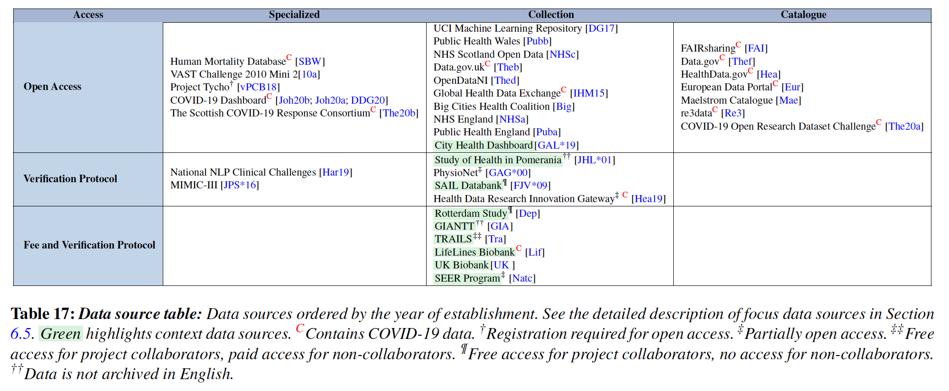
Healthcare Data Set Classification

Slide 36
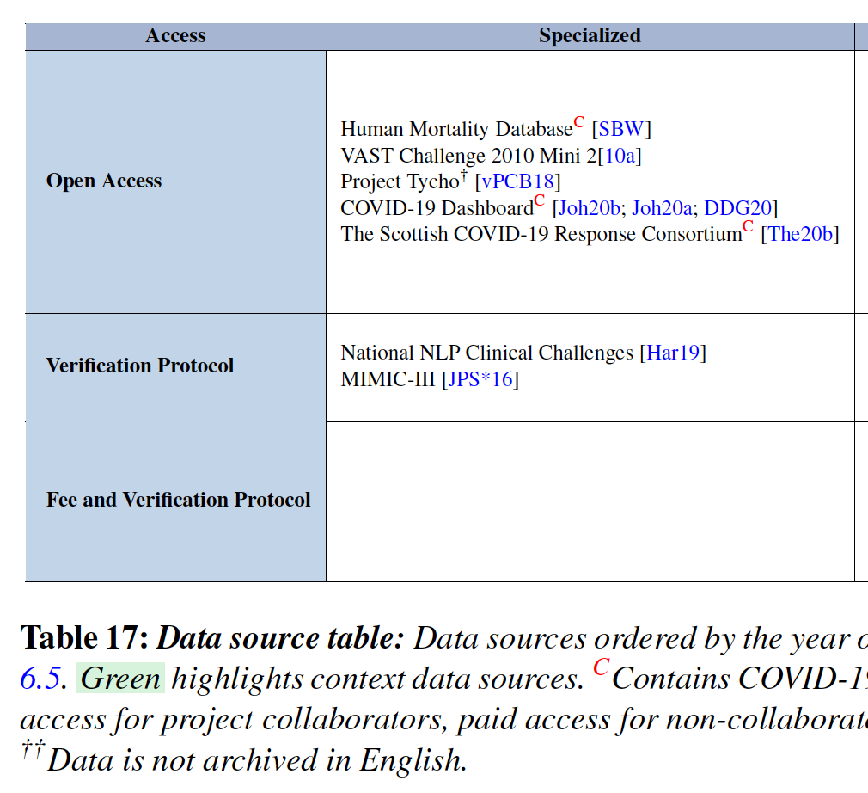
Healthcare Data Set Classification

Slide 37
Future Challenges and Discussion
Scalability (22 papers, 45%)
Evaluation (14 papers, 29%)
Screen Space (12 papers, 24%)
System Usability (12 papers, 24%)
Data Interoperability (10 papers, 20%)
Interaction (9 papers, 18%)
Data Dimensionality (7 papers, 14%)
Data Quality and Uncertainty (7 papers, 14%)
Clustering (4 papers, 8%)
Open Data Access (4 papers, 8%)
Notes:
Top 10 challenges mentioned in all paper.

Slide 38
Thank you for your attention. Any Questions?
This work is funded by EP/S010238/2 from the Engineering and Physical Sciences Research Council (EPSRC).
Acknowledgements

Slide 39
EHR STAR vs Previous Surveys

Slide 40
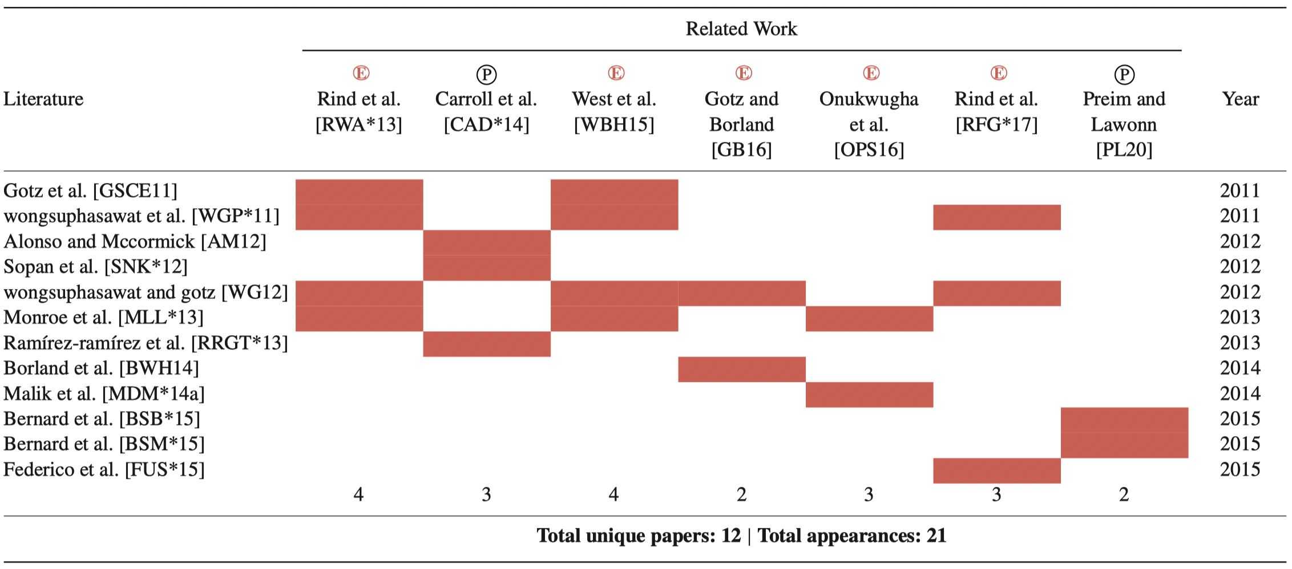
Focus Papers vs Previous Surveys
Notes:
Table 5, Focus papers vs previous surveys

Slide 41
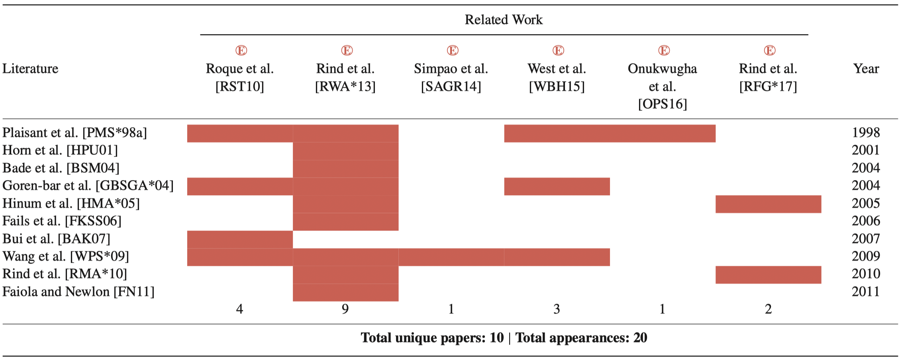
Context Papers vs Previous Surveys
Notes:
Table 6, Context papers vs previous surveys

