Slide 1
An Introduction to Cryptology
An Introduction to Cryptology
Robert Oates
Robert .oates@nottingham.ac.uk

Slide 2

Topics Covered
Concepts of Cryptology
The Mathematics of Cryptology
Algorithms and Mechanisms
  Integrity Checking
  Digital Signatures
  Encryption
Assessment of Algorithms and Mechanisms

Slide 3
Definitions
Cryptography
  The sending and receiving of secret messages
Cryptanalysis
  The interception and analysis of secret messages
Cryptology
  All of the above
Notes:
Can anyone give accurate definitions of these?

Slide 4
The Important Message
CRYPTOLOGY
IS NOT SECURITY
Notes:
Cryptology is a set of algorithms and techniques
Security can use cryptology, but using cryptology doesn’t necessarily make you secure

Slide 5
The Communication Model
Alice
Bob
Eve
Notes:
Two people who trust eachother
The “enemy”, Eve sits between the communications channel

Slide 6
All About Eve
Objectives
Countermeasures
Read messages
Edit Messages
Write messages
Encryption
Integrity Checking
Origin Checking
Notes:
Class discussion

Slide 7
The Computer Security Model
LEA
Customer
Merchant
TTP
Notes:
No trust between the merchant and the customer
Disagreements – customer doesn’t pay, merchant doesn’t send goods etc etc
Need to insert an arbitraitor
Law Enforcement Agency has access to a lot of electronic communication? How could this be abused?

Slide 8
Cryptography Paradigms
SECRET
PROCESS

Slide 9
The Failure of the Secret
Who verifies that your technique is strong enough?
What happens if someone reverse engineers/sells your process?
Notes:
DVD Encryption broken by a 16 year old
Blu-Ray and HD DVD Encryption: Broken by a hacker, using a standard pc in 8 days

Slide 10
The New Paradigm
Known
process

Slide 11
Keys and Strength
“Security is as strong as its weakest link” – Bruce Schneier
Keys vary in strength
Algorithms vary in strength
“Brute Force” attacks

Slide 12
Key Management
Where do we generate keys?
How do we generate keys?
Where are keys stored?
How do we transport keys?
Where are keys used?
How are keys revoked and replaced?

Slide 13
Modulus Mathematics
C = 7
0
C-1
6
1
A = 1
A = 0
A = 7
A = 10
5
B
2
4
3
Notes:
Time of day, days of week, months of the year
Remainder division

Slide 14
Modulus
The modulus of a number
A ≡ B mod C
A % C = B

Slide 15
Properties of the Modulus
Let
a₁ ≡ b₁ mod C
a₂ ≡ b₂ mod C
Then
a₁ + a₂ ≡ b₁ + b₂ (mod C)
a₁a₂ ≡ b₁b₂ (mod C)
Notes:
Question – how could you use modulus mathematics to create a test to see if a number is odd or even?

Slide 16
Properties of Modulus
Constrained to integers so division is complex
Let’s define division as the opposite of multiplication
If f = 1/e (mod C)
  then e*f (mod C) = 1
If multiple solutions exist for 1/e the division is undefined like X/0 in regular mathematics

Slide 17
Modular Division Example
f = 1/3 (Mod 7)
So 3f(Mod 7) = 1
Possible values of f:
  0, 0(Mod 7) = 0
  1, 3(Mod 7) = 3
  2, 6(Mod 7) = 6
  3, 9(Mod 7) = 2
  4, 12(Mod 7) = 5
  5, 15(Mod 7) = 1
  6, 18(Mod 7) = 4
So f = 1/3 (Mod 7) = 5

Slide 18
Undefined Modular Division
What about
  f=5/5 (Mod 10)
  5f (Mod 10) = 5
  0, 0 (Mod 10) = 0
  1, 5 (Mod 10) = 5
  2, 10(Mod 10) = 0
  3, 15 (Mod 10) = 5
  4, 20 (Mod 10) = 0
  Etc
  Undefined – too many answers!
  There are cases where there are no answers!

Slide 19
Primes and Modulus
Let p be a prime number
Let a be an integer
iff a ≢ 0 mod p
There is always another integer d such that:
a.d = 1 mod p
Which means that modular division is always defined for primes
Notes:
If a is not a factor of the prime number

Slide 20
Modulus Mathematics
C = 7
0
a = 3
6
1
d = 1
d = 2
d = 3
d = 4
d = 5
5
B
2
4
3

Slide 21
Fermat’s Little Theorem
iff a ≢ 0 mod p
a^{p-1} = 1 mod p
This yields a good way of testing if a number is prime
  If you calculate a^{p-1} (mod p) for a series of numbers if there are no 1’s it probably isn’t prime!
Notes:
Pierre de Fermat 1640 – no proof – he claimed that the proof was “too long to write down”

Slide 22
Hash Functions
HASH
FUNCTION
x
h(x)
Set length of N bits
Any number of bits

Slide 23
Properties of Hash Functions
Compression
  No matter how long the input is, the output has the same length
Ease of computability
  Given x, it should be easy to find h(x)
Collisions
  It should be “computationally infeasible” to find collisions

Slide 24
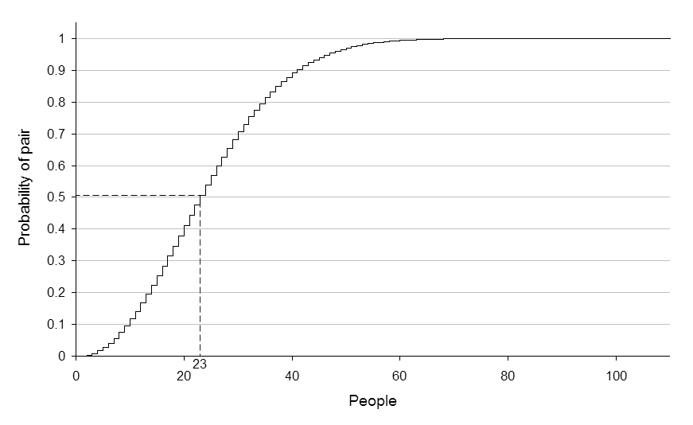
The Birthday Paradox

Slide 25
Properties of Hash Functions
Given a hash function that produces N bit hashes
If you generate around 2^{N/2} random inputs, you are likely to find a collision

Slide 26
Properties of Hash Functions
Preimage Resistance
  Given y, it should be “computationally infeasible” to find x to satisfy:
    h(x) = y
Second Preimage Resistance
  Given x and h(x) it should be “computationally infeasible” to find x’ to satisfy
    h(x) = h(x’)

Slide 27
Properties of Hash Functions
Collision Resistance
  It should be “computationally infeasible” to find any x and x’ that satisfy:
    h(x) = h(x’)

Slide 28
Integrity Checking
MDCs
  Manipulation Detection Codes
  Modification Detection Codes
  Message Integrity Codes
Clean Environment
h(x₁)
h(x₂)
h(x₃)
…
h(x_{n})

Slide 29
MDCs
The MDC is often referred to as:
  Hash value
  Message Digest
  Checksum ← Not a CRC

Slide 30
The Story So Far…
Cryptology paradigms
  The Secret
  The Key
Cryptology as a tool – not a guarantee
Modulus Mathematics
  Fermat’s Little Theorem
Hash functions and their properties
Message Digests

Slide 31
A Naïve Hash Function
h(x) = g^{x} mod p
Where p is a random prime and g is a random non-factor of p

Slide 32
An Advanced Hash Function
X₁
X
X₂
f
f
f
f
X₃
h(0)
h_{m}
X_{n}

Slide 33
Hash Algorithms
SHA-1
MD4
MD5
RIPE-MD
Consult the course text for details of SHA-1
  512bit Blocks
  160bit hash values
Notes:
SHA – Secure Hash Algorithm
MDX – Message Digest
RIPE – many acronyms in one!:
RIPE – RACE Integrity Primitives Evaluation
RACE – R&D in Advanced Communication technologies in Europe
R&D – Research & Development

Slide 34
Message Authentication
MAC
  Message Authentication Codes
Related to MDCs but require an input message AND a key, k
HMAC(x) = h(k||h(k||x))
Where k is padded out to ensure that it is the
length required by the hash function

Slide 35
Message Authentication
Alice
Bob
HMAC
h(message)
Eve

Slide 36
Message Authentication
Alice
Bob
h(message)
Eve

Slide 37
Digital Signatures
MACs verify:
  A message has not been tampered with
  A message has been written by ONE of the key holders
THIS IS NOT ENOUGH!

Slide 38
Digital Signatures
Merchants forging orders
Customers forging receipts
We need to verify EXACTLY who wrote what

Slide 39
Digital Signatures
Signer
Verifier
Document
Document
Document
Hash
Hash
Sign
Signature
Verify
Private
Signature key
Public
verification key

Slide 40
One-time Signatures
These are “disposable signatures” that are used once and thrown out
Document
1
0
1
1
0
1
N bits
Private Key
Public Key
x₀
x₁
x₂
x₃
x₄
x₅
x₆
x₇
x₈
x₉
x₁₀
x₁₁
h(x₀)
h(x₁)
h(x₂)
h(x₃)
h(x₄)
h(x₅)
h(x₆)
h(x₇)
h(x₈)
h(x₉)
h(x₁₀)
h(x₁₁)
2N Values

Slide 41
One-time Signatures
These are “disposable signatures” that are used once and thrown out
Document
1
0
1
1
0
1
Private Key
x₀
x₁
x₂
x₃
x₄
x₅
x₆
x₇
x₈
x₉
x₁₀
x₁₁

Slide 42
One-time Signatures
These are “disposable signatures” that are used once and thrown out
Document
1
0
1
1
Private Key
x₀
x₁
x₂
x₃
x₄
x₅
x₆
x₇
x₈
x₉
x₁₀
x₁₁
0
1

Slide 43
One-time Signatures
These are “disposable signatures” that are used once and thrown out
Document
Private Key
1
h(x₁)
x₀
x₁
0
h(x₂)
x₂
x₃
Document Signature
1
x₄
h(x₅)
x₁, x₂, x₅, x₇, x₈, x₁₁
x₅
1
x₆
x₇
h(x₇)
0
x₈
h(x₈)
x₉
1
x₁₁
x₁₀
h(x₁₁)

Slide 44
One-time Signatures
These are “disposable signatures” that are used once and thrown out
Document
Signature
Public Key
1
x₁
h(x₀)
h(x₁)
0
x₂
h(x₂)
h(x₃)
1
x₅
h(x₄)
h(x₅)
1
x₇
h(x₆)
h(x₇)
0
x₈
h(x₈)
h(x₉)
1
x₁₁
h(x₁₁)
h(x₁₀)
h(x₁₁)

Slide 45
Encryption
Protecting the confidentiality of data
X is the plaintext
eK(X) is the encrypted text, using key K
dK(Y) is the decryption of ciphertext Y using key K

Slide 46
Public Key Encryption
There are a huge number of encryption algorithms
Most public key encryption relies on a similar core principal
This is a simplified version of RSA which communicates the core ideas

Slide 47
Public Key Encryption
How can we make our key and algorithm public without others intercepting all our messages?
Two magic equations from Number Theory

Slide 48
Public Key Encryption Example
Let’s send and receive a secret message
Generate the receiver’s private keys, p & q
  11, 17
Generate a public key N
  11 x 17 = 187
The sender then encrypts the message, using the public key and the first equation.
  We’ll send the letter ‘X’ (ASCII 88)

Slide 49
Public Key Decryption
We can now use the second equation to decrypt the message

Slide 50
Feistal Networks
Many cryptography schemes are based on Feistal Networks

Slide 51
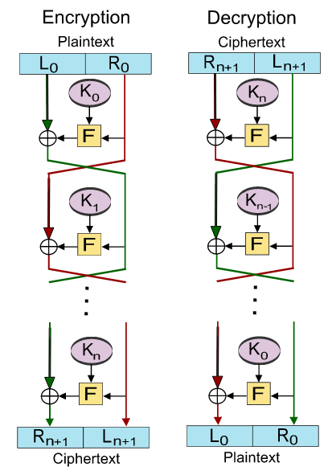
Feistal Networks
*taken from Wikipedia!

Slide 52
Feistal Networks
DES
F
EXOR – Mixes the input signals
Substitution – Replaces some bits with new values
Permutation – Swaps some of the values around
Notes:
DES – Data Encryption Standard
Uses 16 rounds

Slide 53
Assessment of Mechanisms
There are no hard and fast rules for determining the security of an algorithm

Slide 54
Encryption
There are different ways of describing encryption algorithms
Symmetry
Asymmetrical
Symmetrical
Determinism
Deterministic
Probabalistic
Fixed Length
Block Ciphers
Stream Cipher
Notes:
Block ciphers encode large blocks of data simultaneously and use the same key for all
Stream ciphers encrypt small pieces of data at a time and constantly changes its key

Slide 55
Assessment of Mechanisms
Algorithm
Cycles/byte
RC4
MD5
SHA-1
SHA2-512
AES
DES
7-8
7-8
15
83
25-30
60
Notes:
The performance is important not just for the speed of transmission
The slower the protocol- the more frustrated your users become, and the more likely they are to stop using it, or cut corners

Slide 56
Assessment of Mechanisms
In general algorithms are:
  Empirically Secure
    An algorithm that has been out in the wild for a long time without failure. Theoretical weaknesses exist – but no attacks have been successfully executed

Slide 57
Assessment of Mechanisms
In general algorithms are:
Provably Secure
  Breaking the algorithm has been shown to be equivalent to another problem that we already know is hard! Examples include some games and many optimisation problems.
  These are generally breakable – given enough time and resources

Slide 58
Assessment of Mechanisms
In general algorithms are:
Unconditionally Secure
  Algorithms that are totally secure – if used properly!

Slide 59
Assessment of Mechanisms
Mechanisms are only as strong as their users!
  Insider Attacks
  Statistical Analysis
  Stupidity!

