Slide 1
Machine Learning
Lecture 1
Introduction

Slide 2
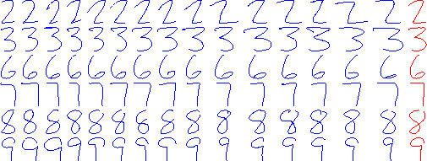
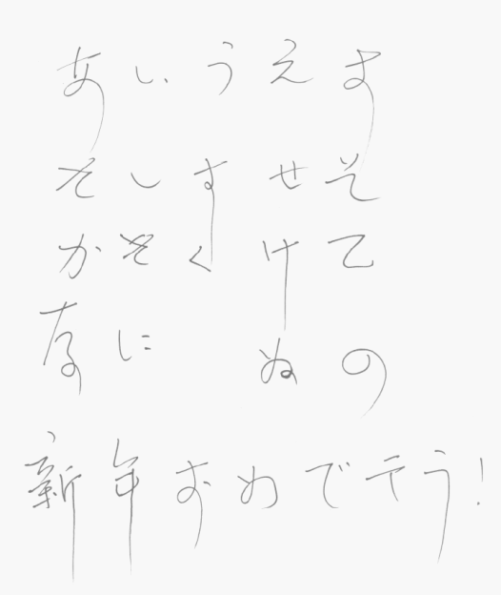
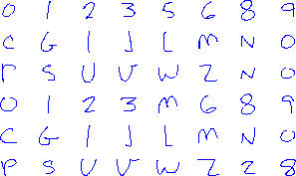
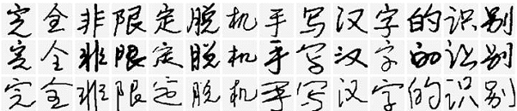
Motivating Problems
Handwritten Character Recognition

Slide 3
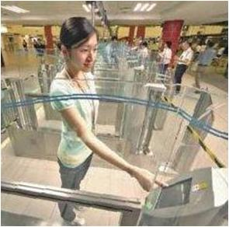
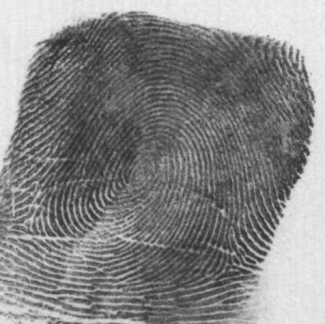


Motivating Problems
Fingerprint Recognition (e.g., border control)

Slide 4

Motivating Problems
Face Recognition (security access to buildings etc)

Slide 5
Can Machines Learn to Solve These Problems?
Or, to be more precise
  Can we program machines to learn to do these tasks?

Slide 6
Definition of Learning
A computer program is said to learn from experience E with respect to some class of tasks T and performance measure P, if its performance at tasks in T, as measured by P, improves with experience E
(Mitchell, Machine Learning, McGraw-Hill, 1997)

Slide 7
Definition of Learning
What does this mean exactly?
  Handwriting recognition problem
    Task T: Recognizing hand written characters
    Performance measure P: percent of characters correctly classified
    Training experience E: a database of handwritten characters with given classifications

Slide 8
Design a Learning System
We shall use handwritten Character recognition as an example to illustrate the design issues and approaches

Slide 9
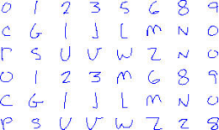
Design a Learning System
Step 0:
  Lets treat the learning system as a black box
Learning System
Z

Slide 10
Design a Learning System
Step 1: Collect Training Examples (Experience).
  Without examples, our system will not learn (so-called learning from examples)
2
3
6
7
8
9

Slide 11
Design a Learning System
Step 2: Representing Experience
  Choose a representation scheme for the experience/examples
    The sensor input represented by an n-d vector, called the feature vector, X = (x₁, x₂, x₃, …, x_{n})
(1,1,0,1,1,1,1,1,1,1,0,0,0,0,1,1,1, 1,1,0, …., 1) 64-d Vector
(1,1,1,1,1,1,1,1,1,1,0,0,1,1,1,1,1, 1,1,0, …., 1) 64-d Vector

Slide 12
Design a Learning System
Step 2: Representing Experience
  Choose a representation scheme for the experience/examples
    The sensor input represented by an n-d vector, called the feature vector, X = (x1, x2, x3, …, xn)
    To represent the experience, we need to know what X is.
    So we need a corresponding vector D, which will record our knowledge (experience) about X
    The experience E is a pair of vectors E = (X, D)

Slide 13
Design a Learning System
Step 2: Representing Experience
  Choose a representation scheme for the experience/examples
    The experience E is a pair of vectors E = (X, D)
  So, what would D be like? There are many possibilities.

Slide 14
Design a Learning System
Step 2: Representing Experience
  So, what would D be like? There are many possibilities.
  Assuming our system is to recognise 10 digits only, then D can be a 10-d binary vector; each correspond to one of the digits
D = (d0, d1, d2, d3, d4, d5, d6, d7, d8, d9)
e.g,
if X is digit 5, then d5=1; all others =0
If X is digit 9, then d9=1; all others =0

Slide 15
Design a Learning System
Step 2: Representing Experience
  So, what would D be like? There are many possibilities.
  Assuming our system is to recognise 10 digits only, then D can be a 10-d binary vector; each correspond to one of the digits
D = (d0, d1, d2, d3, d4, d5, d6, d7, d8, d9)
X = (1,1,0,1,1,1,1,1,1,1,0,0,0,0,1,1,1, 1,1,0, …., 1); 64-d Vector
D= (0,0,0,0,0,1,0,0,0,0)
X= (1,1,1,1,1,1,1,1,1,1,0,0,1,1,1,1,1, 1,1,0, …., 1); 64-d Vector
D= (0,0,0,0,0,0,0,0,1,0)

Slide 16
Design a Learning System
Step 3: Choose a Representation for the Black Box
  We need to choose a function F to approximate the block box. For a given X, the value of F will give the classification of X. There are considerable flexibilities in choosing F
Learning System
F
X
F(X)

Slide 17
Design a Learning System
Step 3: Choose a Representation for the Black Box
  F will be a function of some adjustable parameters, or weights, W = (w1, w2, w3, …w_{N}), which the learning algorithm can modify or learn
Learning System
F(W)
X
F(W,X)

Slide 18
Design a Learning System
Step 4: Learning/Adjusting the Weights
  We need a learning algorithm to adjust the weights such that the experience/prior knowledge from the training data can be learned into the system:
E=(X,D)
F(W,X) = D

Slide 19
Design a Learning System
Step 4: Learning/Adjusting the Weights
Adjust W
E=(X,D)
Learning System
F(W)
X
F(W,X)
D
Error = D-F(W,X)

Slide 20
Design a Learning System
Step 5: Use/Test the System
  Once learning is completed, all parameters are fixed. An unknown input X is presented to the system, the system computes its answer according to F(W,X)
Learning System
F(W)
X
F(W,X)
Answer

Slide 21
Revision of Some Basic Maths
Vector and Matrix
  Row vector/column vector/vector transposition
  Vector length/norm
  Inner/dot product
  Matrix (vector) multiplication
  Linear algebra
  Euclidean space
Basic Calculus
  Partial derivatives
  Gradient
  Chain rule

Slide 22
Revision of Some Basic Maths
Inner/dot product
    x = [x₁, x₁, …, x_{n} ]^{T} , y = [y₁, y₁, …, y_{n} ]^{T}
    Inner/dot product of x and y, x^{T}y
Matrix/Vector multiplication

Slide 23
Revision of Some Basic Maths
Vector space/Euclidean space
    A vector space V is a set that is closed under finite vector addition and scalar multiplication.
    The basic example is n-dimensional Euclidean space, where every element is represented by a list of n real numbers
    An n-dimensional real vector corresponds to a point in the Euclidean space.
      [1, 3] is a point in 2-dimensional space
      [2, 4, 6] is point in 3-dimensional space

Slide 24
Revision of Some Basic Maths
Vector space/Euclidean space
  Euclidean space (Euclidean distance)
  Dot/inner product and Euclidean distance
    Let x and y are two normalized n vectors, ||x||= 1, ||y||=1, we can write
    Minimization of Euclidean distance between two vectors corresponds to maximization of their inner product.
  Euclidean distance/inner product as similarity measure

Slide 25
Revision of Some Basic Maths
Basic Calculus
  Multivariable function:
  Partial derivative: gives the direction and speed of change of y, with respect to xi
  Gradient
  Chain rule: Let y = f (g(x)), u = g(x), then
  Let z = f(x, y), x = g(t), y = h(t), then

Slide 26
Feature Space
Representing real world objects using feature vectors
i
2
3
1
x₂(i)
4
x₁(i)
6
5
7
x₁
X(i) =[x₁(i), x₂(i)]
9
10
12
11
Feature Vector
13
x₁(i)
14
8
Feature Space
15
16
Elliptical blobs (objects)
x₂
x₂(i)

Slide 27
Feature Space
From Objects to Feature Vectors to Points in the Feature Spaces
x₁
X(15)
1
2
3
X(1)
X(7)
4
X(16)
6
5
X(3)
X(8)
7
X(25)
X(12)
9
10
12
11
X(13)
X(6)
13
X(9)
14
8
X(10)
X(4)
15
16
X(11)
X(14)
Elliptical blobs (objects)
x₂

Slide 28
Representing General Objects
Feature vectors of
  Faces
  Cars
  Fingerprints
  Gestures
  Emotions (a smiling face, a sad expression etc)
  …

Slide 29
Further Reading
T. M. Mitchell, Machine Learning, McGraw-Hill International Edition, 1997
Chapter 1

Slide 30
Tutorial/Exercise Questions
Describe informally in one paragraph of English, the task of learning to recognize handwriting numerical digits.
Describe the various steps involved in designing a learning system to perform the task of question 1, give as much detail as possible the tasks that have to be performed in each step.
For the tasks of learning to recognize human faces and fingerprints respectively, redo questions 1 and 2.
In the lecture, we used a very long binary vector to represent the handwriting digits, can you think of other representation methods?

