Slide 1
Machine Learning
Lecture 2
Perceptron

Slide 2
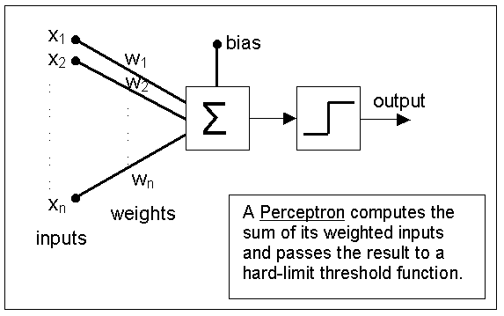
Perceptron - Basic
Perceptron is a type of artificial neural network (ANN)

Slide 3
Perceptron - Operation
It takes a vector of real-valued inputs, calculates a linear combination of these inputs, then output 1 if the result is greater than some threshold and -1 otherwise

Slide 4
Perceptron – Decision Surface
Perceptron can be regarded as representing a hyperplane decision surface in the n-dimensional feature space of instances.
The perceptron outputs a 1 for instances lying on one side of the hyperplane and a -1 for instances lying on the other side.
This hyperplane is called the Decision Surface

Slide 5
Perceptron – Decision Surface
In 2-dimensional space
w₀
x₁
w₁
w₂
x₂
Decision Surface (Line)
o=-1
o=+1

Slide 6
Perceptron – Representation Power
The Decision Surface is linear
Perceptron can only solve Linearly Separable Problems
+ + +
+ + + +
+ + +
- - -
- - -
- - -

Slide 7
Perceptron – Representation Power
Can represent many boolean functions: Assume boolean values of 1 (true) and -1 (false)
AND
W₀=-0.8
x₁
W₁=0.5
x1 x2 D
-1 -1 -1
-1 +1 -1
+1 -1 -1
+1 +1 +1
x₂
W₂=0.5
Decision Surface
(-1,+1)
(+1,+1)
(-1,-1)
+1,-1)

Slide 8
Perceptron – Representation Power
Can represent many boolean functions: Assume boolean values of 1 (true) and -1 (false)
OR
W₀=?
x₁
W₁=?
x1 x2 D
-1 -1 -1
-1 +1 +1
+1 -1 +1
+1 +1 +1
x₂
W₂=?
Decision Surface
(-1,+1)
(+1,+1)
(-1,-1)
+1,-1)

Slide 9
Perceptron – Representation Power
Separate the objects from the rest
x₁
1
2
3
4
6
5
7
9
10
12
11
14
13
8
15
16
Elliptical blobs (objects)
x₂

Slide 10
Perceptron – Representation Power
Some problems are linearly non-separable
XOR
Decision Surface:
It doesn’t matter where you place the line (decision surface), it is impossible to separate the space such that on one side we have D = 1 and on the other we have D = -1
x1 x2 D
-1 -1 -1
-1 +1 +1
+1 -1 +1
+1 +1 -1
(-1,+1)
(+1,+1)
W₀=?
x₁
W₁=?
(-1,-1)
(+1,-1)
Perceptron Cannot Solve such Problem!
x₂
W₂=?

Slide 11
Perceptron – Training Algorithm
Separate the objects from the rest
W₀=?
x₁
W₁=?
x₂
W₂=?
x₁
We are given the training sample (experience ) pairs (X, D), how can we determine the weights that will produce the correct +1 and -1 outputs for the given training samples?
x₂

Slide 12
Perceptron – Training Algorithm
Training sample pairs (X, d), where X is the input vector, d is the input vector’s classification (+1 or -1) is iteratively presented to the network for training, one at a time, until the process converges

Slide 13
Perceptron – Training Algorithm
The Procedure is as follows
    Set the weights to small random values, e.g., in the range (-1, 1)
    Present X, and calculate
    Update the weights
    Repeat by going to step 2
x₀=1 (constant)

Slide 14
Perceptron – Training Algorithm
Example
W₀=0.5
x1 x2 D
-1 -1 -1
-1 +1 +1
+1 -1 +1
+1 +1 +1
x₁
W₁=0.5
x₂
W₂=0.5

Slide 15
Perceptron – Training Algorithm
Convergence Theorem
  The perceptron training rule will converge (finding a weight vector correctly classifies all training samples) within a finite number of iterations, provided the training examples are linearly separable and provided a sufficiently small η is used.

Slide 16
Further Reading
T. M. Mitchell, Machine Learning, McGraw-Hill International Edition, 1997
Chapter 4

Slide 17
Tutorial/Exercise Questions
What is the weight values of a perceptron having the following decision surfaces
Design two-input perceptrons for implementing the following boolean functions
    AND, OR, NAND, NOR
A single layer perceptron is incapable of learning simple functions such as XOR (exclusive OR). Explain why this is the case (hint: use the decision boundary)
x₂
x₂
1
1
x₁
x₁
-1.5
2
(a)
(b)

Slide 18
Tutorial/Exercise Questions
A single layer Perceptron is as follows
  Write down and plot the equation of the decision boundary of this device
  Change the values of w1 and w2 so that the Perceptron can separate following two-class patterns
    Class 1 Patterns: (1, 2), (1.5. 2.5), (1, 3)
    Class 2 Patterns: (2, 1.5), (2, 1)

