Slide 1
Machine Learning
Lecture 3
ADLINE and Delta Rule

Slide 2
The ADLINE and Delta Rule
Adaptive Linear Element (ADLINE) VS Perceptron
w₀
w₀
x₁
w₁
x₁
w₁
o
o
x₂
x₂
w_{n}
w_{n}
x_{n}
x_{n}

Slide 3
The ADLINE and Delta Rule
Adaptive Linear Element (ADLINE) VS Perceptron
  When the problem is not linearly separable, perceptron will fail to converge
  ADLINE can overcome this difficulty by finding a best fit approximation to the target.

Slide 4
The ADLINE Error Function
We have training pairs (X(k), d(k), k =1, 2, …, K), where K is the number of training samples, the training error specifies the difference between the output of the ALDLINE and the desired target
The error is defined as
w₀
x₁
w₁
o
x₂
w_{n}
x_{n}
is the output of presenting the training input X(k)

Slide 5
The ADLINE Error Function
The error is defined as
The smaller E(W) is, the closer is the approximation
We need to find W, based on the given training set, that minimizes the error E(W)

Slide 6
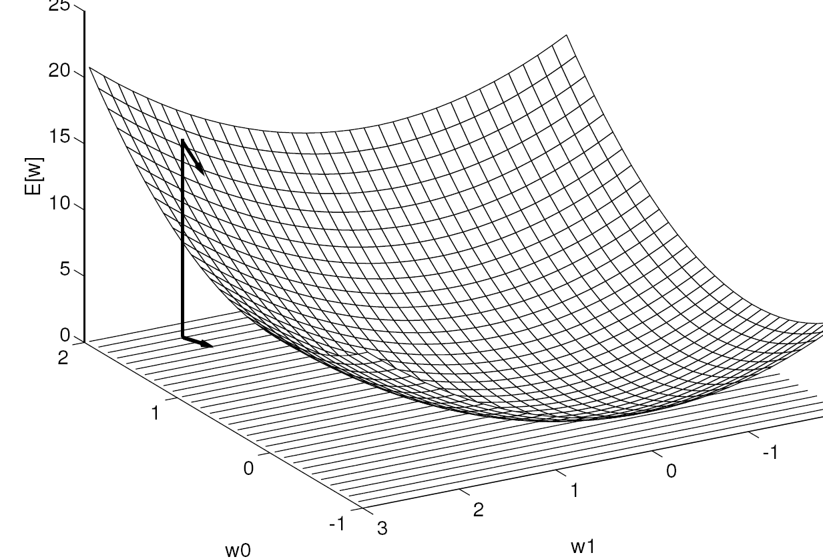
The ADLINE Error Function
Error Surface

Slide 7
The Gradient Descent Rule
An intuition
  Before we formally derive the gradient decent rule, here is an intuition of what we should be doing
E(w)
We want to move w(0) to a new value,
such that E(W(new))<E(w(0))
E(w(0))
Error surface
w
W(0)
randomly chosen initial weight

Slide 8
The Gradient Descent Rule
An intuition
  Before we formally derive the gradient decent rule, here is an intuition of what we should be doing
E(w)
We want to move w(0) to a new value,
Such that E(W(new))<E(w(0))
E(w(0))
Which direction should we move w(0)
Error surface
w
W(0)
randomly chosen initial weight

Slide 9
The Gradient Descent Rule
An intuition
  Before we formally derive the gradient decent rule, here is an intuition of what we should be doing
E(w)
We want to move w(0) to a new value,
Such that E(W(new))<E(w(0))
E(w(0))
Which direction should we move w(0)
Error surface
w
w(new)
W(0)
randomly chosen initial weight

Slide 10
The Gradient Descent Rule
An intuition
  Before we formally derive the gradient decent rule, here is an intuition of what we should be doing
E(w)
We want to move w(0) to a new value,
Such that E(W(new))<E(w(0))
How do we know which direction to move?
E(w(0))
Error surface
w
w(new)
W(0)
randomly chosen initial weight

Slide 11
The Gradient Descent Rule
An intuition
  Before we formally derive the gradient decent rule, here is an intuition of what we should be doing
E(w)
We want to move w(0) to a new value,
Such that E(W(new))<E(w(0))
The sign of the gradient at w(0)
Error surface
w
w(new)
W(0)
randomly chosen initial weight

Slide 12
The Gradient Descent Rule
An intuition
  Before we formally derive the gradient decent rule, here is an intuition of what we should be doing
E(w)
We want to move w(0) to a new value,
Such that E(W(new))<E(w(0))
The sign of the gradient at w(0)
Error surface
w
w(new)
W(0)
randomly chosen initial weight

Slide 13
The Gradient Descent Rule
An intuition
  The intuition leads to

Slide 14
The Gradient Descent Rule
Formal Derivation of Gradient Descent
  The gradient of E is a vector, whose components are the partial derivatives of E with respect to each of the wi
  The gradient specifies the direction that produces the speepest increase in E.
  Negative of the vector gives the direction of steepest decrease.

Slide 15
The Gradient Descent Rule
The gradient training rule is
η is the training rate

Slide 16
The Gradient Descent Rule
Gradient of ADLINE Error Functions

Slide 17
The Gradient Descent Rule
ADLINE weight updating using gradient descent rule

Slide 18
The Gradient Descent Rule
Gradient descent training procedure
  Initialise w_{i} to small vales, e.g., in the range of (-1, 1), choose a learning rate, e.g., η = 0.2
  Until the termination condition is met, Do
    For all training sample pair (X(k), d(k)), input the instance X(k) and compute
    For each weight w_{i}, Do
Batch Mode:
gradients accumulated over ALL samples first
Then update the weights

Slide 19
Stochastic (Incremental) Gradient Descent
Also called online mode, Least Mean Square (LMS), Widrow-Hoff, and Delta Rule
  Initialise w_{i} to small vales, e.g., in the range of (-1, 1), choose a learning rate, e.g., η = 0.01 (should be smaller than batch mode)
  Until the termination condition is met, Do
    For EACH training sample pair (X(k), d(k)), compute
    For each weight w_{i}, Do
Online Mode:
Calculate gradient for EACH samples
Then update the weights

Slide 20
Training Iterations, Epochs
Training is an iterative process; training samples will have to be used repeatedly for training
Assuming we have K training samples [(X(k), d(k)), k=1, 2, …, K]; then an epoch is the presentation of all K sample for training once
  First epoch: Present training samples: (X(1), d(1)), (X(2), d(2)), … (X(K), d(K))
  Second epoch: Present training samples: (X(K), d(K)), (X(K-1), d(K-1)), … (X(1), d(1))
  Note the order of the training sample presentation between epochs can (and should normally) be different.
Normally, training will take many epochs to complete

Slide 21
Termination of Training
To terminate training, there are normally two ways
  When a pre-set number of training epochs is reached
  When the error is smaller than a pre-set value

Slide 22
Gradient Descent Training
A worked Example
W₀
x₁
W₁
x1 x2 D
-1 -1 -1
-1 +1 +1
+1 -1 +1
+1 +1 +1
x₂
W₂
Initialization
W₀(0)=0.1; W₁(0)=0.2; W₂(0)=0.3;
η=0.5

Slide 23
Further Readings
T. M. Mitchell, Machine Learning, McGraw-Hill International Edition, 1997
Chapter 4
Any other relevant books/papers

Slide 24
Tutorial/Exercise Questions
Derive a gradient descent training rule for a single unit with output y
A network consists of two ADLINE units N1 and N2 is shown as follows. Derive a delta training rule for all the weights
+1
+1
x₁
w₀
w₄
w₁
w₃
N1
N2
y
x₂
w₂

Slide 25
Tutorial/Exercise Questions
The connection weights of a two-input ADLINE at time n have following values:
w₀ (n) = -0.5 w₁ (n) = 0.1 w₂ (n) = -0.3.
The training sample at time n is:
x₁ (n) = 0.6 x₂ (n) = 0.8
The corresponding desired output is d(n) = 1
Base on the Least-Mean-Square (LMS) algorithm, derive the learning equations for each weight at time n
Assume a learning rate of 0.1, compute the weights at time (n+1):
    w₀ (n+1), w₁ (n+1), and w₂ (n+1).

