Slide 1
Machine Learning
Lecture 4
Multilayer Perceptrons

Slide 2
Limitations of Single Layer Perceptron
Only express linear decision surfaces
w₀
w₀
x₁
w₁
x₁
w₁
y
y
x₂
x₂
w_{n}
w_{n}
x_{n}
x_{n}

Slide 3
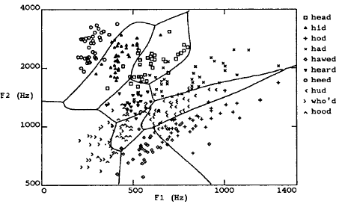
Nonlinear Decision Surfaces
A speech recognition task involves distinguishing 10 possible vowels all spoken in the context of ‘h_d” (i.e., hit, had, head, etc). The input speech is represented by two numerical parameters obtained from spectral analysis of the sound, allowing easy visualization of the decision surfaces over the 2d feature space.

Slide 4
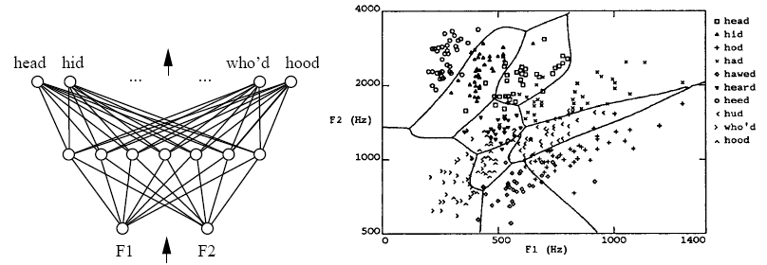
Multilayer Network
We can build a multilayer network represent the highly nonlinear decision surfaces
How?

Slide 5
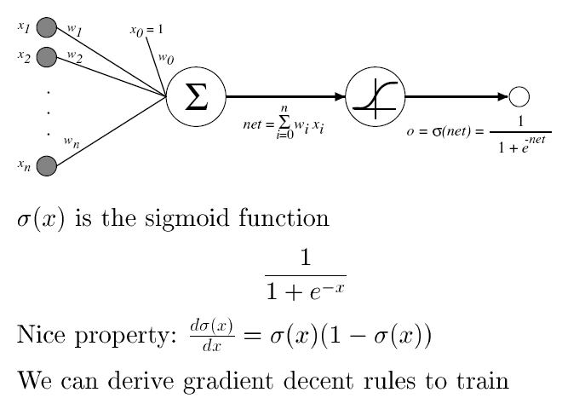
Sigmoid Unit

Slide 6
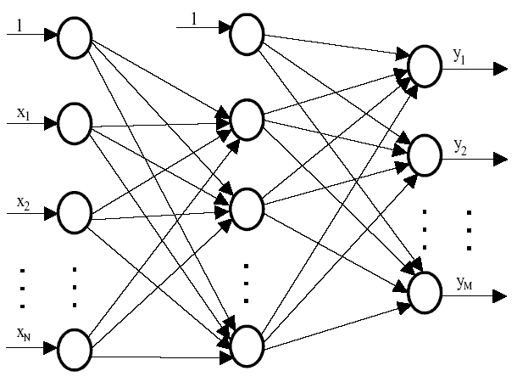
Multilayer Perceptron
A three layer perceptron
Sigmoid units
Fan-out units
o₁
o₂
o_{M}

Slide 7
Multilayer Perceptron
A three layer perceptron
Hidden units
Output units
Input units
o₁
o₂
o_{M}

Slide 8
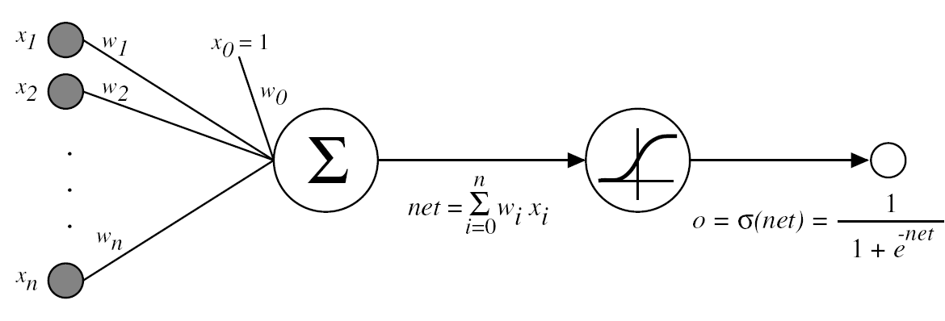
Error Gradient for a Sigmoid Unit
d(k)
X(k)

Slide 9
Error Gradient for a Sigmoid Unit

Slide 10
Error Gradient for a Sigmoid Unit

Slide 11
Back-propagation Algorithm
For training multilayer perceptrons
o₁
o₂
o_{M}

Slide 12
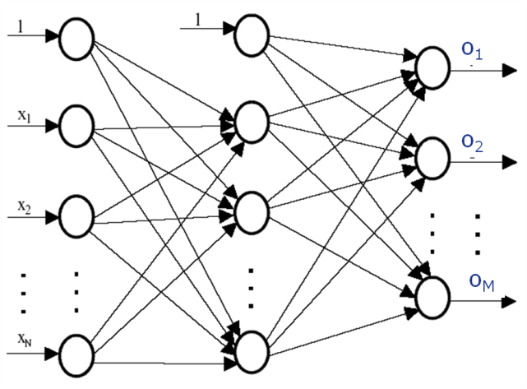
Back-propagation Algorithm
For each training example, training involves following steps
X
d₁, d₂, …d_{M}
Step 1: Present the training sample, calculate the outputs

Slide 13
Back-propagation Algorithm
For each training example, training involves following steps
X
d₁, d₂, …d_{M}
Step 2: For each output unit k, calculate

Slide 14
Back-propagation Algorithm
For each training example, training involves following steps
X
d₁, d₂, …d_{M}
Output unit k
Step 3: For hidden unit h, calculate
w_{h,k}
Hidden unit h
Error back-propagation

Slide 15
Back-propagation Algorithm
For each training example, training involves following steps
X
d₁, d₂, …d_{M}
Step 4: Update the output layer weights, w_{h,k}
Output unit k
w_{h,k}
where o_{h} is the output of hidden layer h
Hidden unit h

Slide 16
Back-propagation Algorithm
For each training example, training involves following steps
X
d₁, d₂, …d_{M}
o_{h} is the output of hidden unit h
Output unit k
x_{i}
w_{h,k}
w_{i, h}
Hidden unit h

Slide 17
Back-propagation Algorithm
For each training example, training involves following steps
X
d₁, d₂, …d_{M}
Step 4: Update the output layer weights, w_{h,k}

Slide 18
Back-propagation Algorithm
For each training example, training involves following steps
X
d₁, d₂, …d_{M}
Step 5: Update the hidden layer weights, w_{i,h}
Output unit k
x_{i}
w_{h,k}
w_{i, h}
Hidden unit h

Slide 19
Back-propagation Algorithm
Gradient descent over entire network weight vector
Will find a local, not necessarily a global error minimum.
In practice, it often works well (can run multiple times)
Minimizes error over all training samples
  Will it generalize will to subsequent examples? i.e., will the trained network perform well on data outside the training sample
Training can take thousands of iterations
After training, use the network is fast

Slide 20
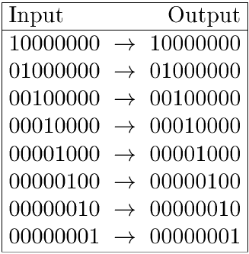
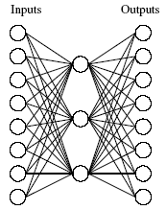
Learning Hidden Layer Representation
Can this be learned?

Slide 21
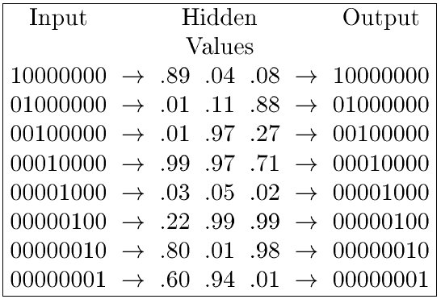
Learning Hidden Layer Representation
Learned hidden layer representation

Slide 22
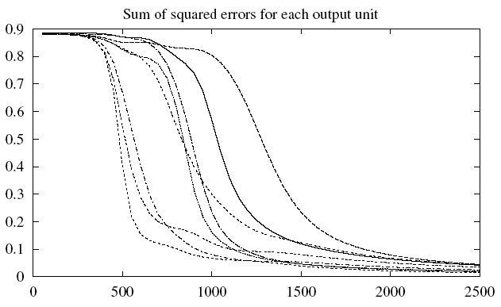
Learning Hidden Layer Representation
Training
The evolving sum of squared errors for each of the eight output units

Slide 23
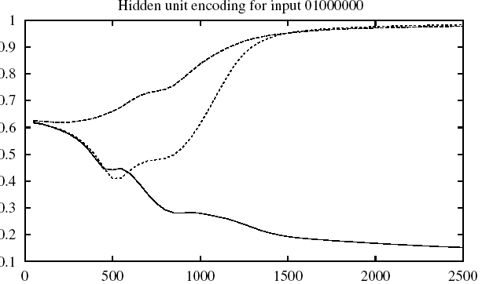
Learning Hidden Layer Representation
Training
The evolving hidden layer representation for the input “01000000”

Slide 24
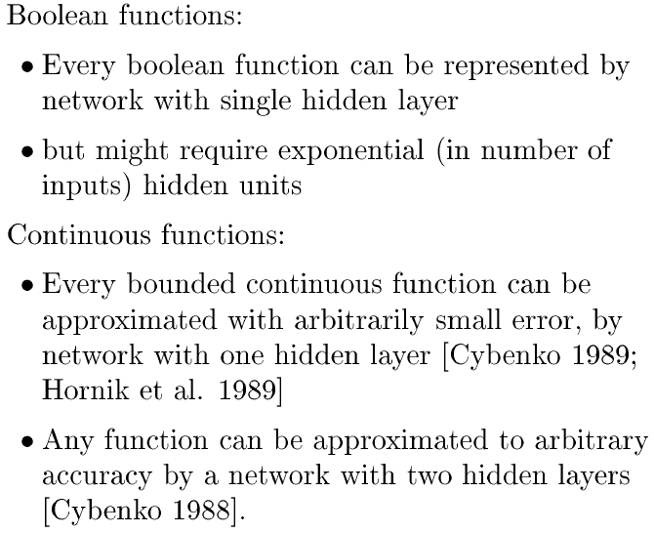
Expressive Capabilities

Slide 25
Generalization, Overfitting and Stopping Criterion
What is the appropriate condition for stopping weight update loop?
  Continue until the error E falls below some predefined value
    Not a very good idea – Back-propagation is susceptible to overfitting the training example at the cost of decreasing generalization accuracy over other unseen examples

Slide 26
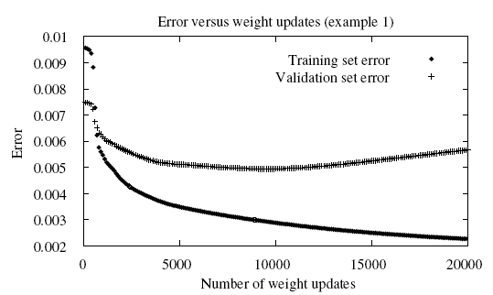
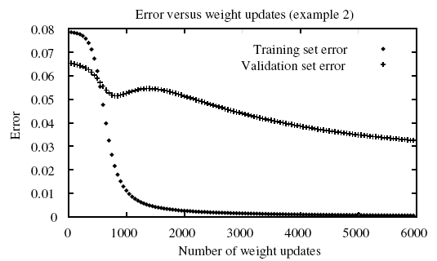
Generalization, Overfitting and Stopping Criterion
A training set
A validation set
Stop training when the validation set has the lowest error

Slide 27
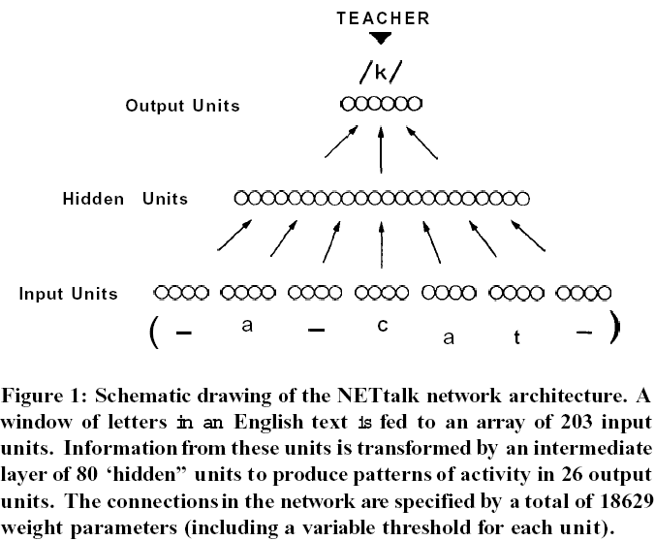
Application Examples
NETtalk (http://www.cnl.salk.edu/ParallelNetsPronounce/index.php)
Training a network to pronounce English text

Slide 28
Application Examples
NETtalk (http://www.cnl.salk.edu/ParallelNetsPronounce/index.php)
Training a network to pronounce English text
  The input to the network: 7 consecutive characters from some written text, presented in a moving windows that gradually scanned the text
  The desired output: A phoneme code which could be directed to a speech generator, given the pronunciation of the letter at the centre of the input window
  The architecture: 7x29 inputs encoding 7 characters (including punctuation), 80 hidden units and 26 output units encoding phonemes.

Slide 29
Application Examples
NETtalk (http://www.cnl.salk.edu/ParallelNetsPronounce/index.php)
Training a network to pronounce English text
  Training examples: 1024 words from a side-by-side English/phoneme source
  After 10 epochs, intelligible speech
  After 50 epochs, 95% accuracy
  It first learned gross features such as the division points between words and gradually refines its discrimination, sounding rather like a child learning to talk

Slide 30
Application Examples
NETtalk (http://www.cnl.salk.edu/ParallelNetsPronounce/index.php)
Training a network to pronounce English text
  Internal Representation: Some internal units were found to be representing meaningful properties of the input, such as the distinction between vowels and consonants.
  Testing: After training, the network was tested on a continuation of the side-by-side source, and achieved 78% accuracy on this generalization task, producing quite intelligible speech.
  Damaging the network by adding random noise to the connection weights, or by removing some units, was found to degrade performance continuously (not catastrophically as expected for a digital computer), with a rather rapid recovery after retraining.

Slide 31
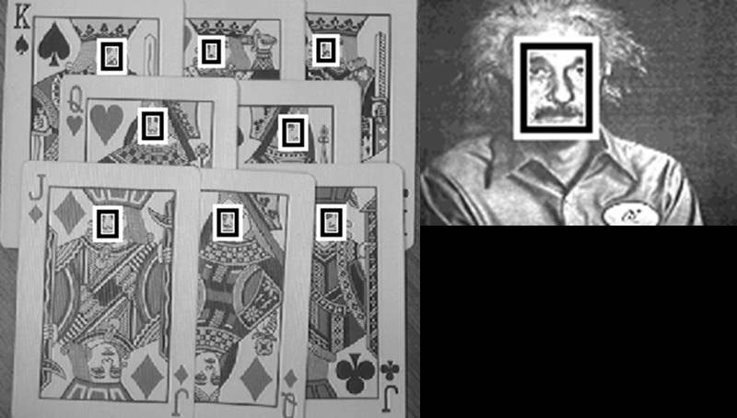
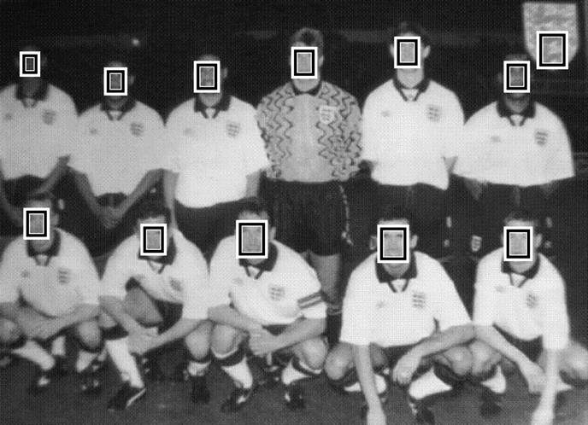

Application Examples
Neural Network-based Face Detection

Slide 32

Application Examples
Neural Network-based Face Detection
Face/
Nonface
NN
Detection
Model

Slide 33
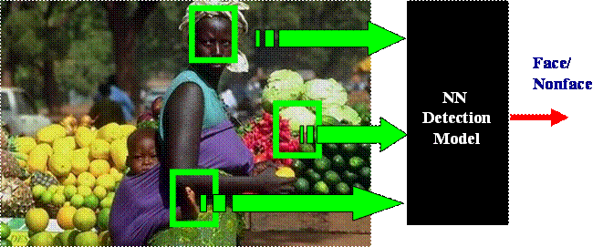
Application Examples
Neural Network-based Face Detection
  It takes 20 x 20 pixel window, feeds it into a NN, which outputs a value ranging from –1 to +1 signifying the presence or absence of a face in the region
  The window is applied at every location of the image
  To detect faces larger than 20 x 20 pixel, the image is repeatedly reduced in size

Slide 34
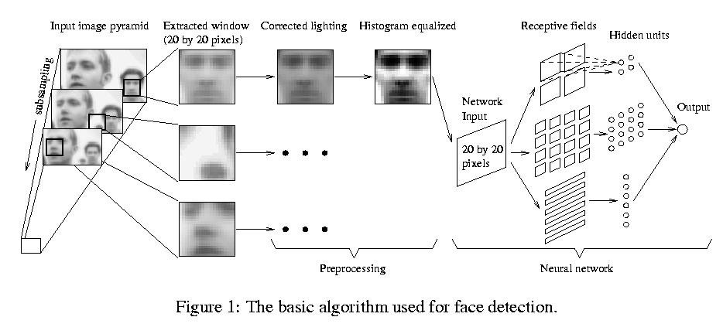
Application Examples
Neural Network-based Face Detection (http://www.ri.cmu.edu/projects/project_271.html)

Slide 35
Application Examples
Neural Network-based Face Detection (http://www.ri.cmu.edu/projects/project_271.html)
  Three-layer feedforward neural networks
  Three types of hidden neurons
    4 look at 10 x 10 subregions
    16 look at 5x5 subregions
    6 look at 20x5 horizontal stripes of pixels

Slide 36
Application Examples
Neural Network-based Face Detection (http://www.ri.cmu.edu/projects/project_271.html)
  Training samples
  1050 initial face images. More face example are generated from this set by rotation and scaling. Desired output +1
  Non-face training samples: Use a bootstrappng technique to collect 8000 non-face training samples from 146,212,178 subimage regions! Desired output -1

Slide 37
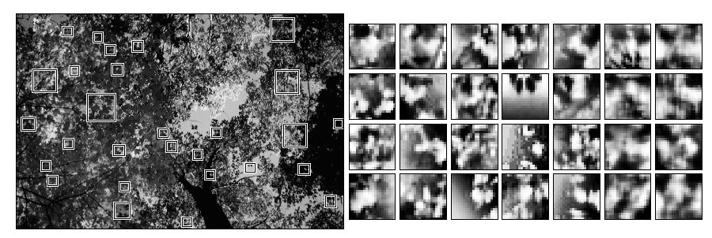
Application Examples
Neural Network-based Face Detection (http://www.ri.cmu.edu/projects/project_271.html)
Training samples: Non-face training samples

Slide 38
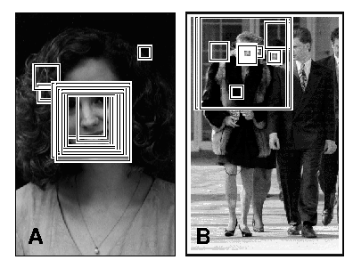
Application Examples
Neural Network-based Face Detection (http://www.ri.cmu.edu/projects/project_271.html)
Post-processing and face detection

Slide 39
Application Examples
Neural Network-based Face Detection (http://www.ri.cmu.edu/projects/project_271.html)
  Results and Issues
  77.% ~ 90.3% detection rate (130 test images)
  Process 320x240 image in 2 – 4 seconds on a 200MHz R4400 SGI Indigo 2

Slide 40
Further Readings
T. M. Mitchell, Machine Learning, McGraw-Hill International Edition, 1997
Chapter 4

Slide 41
Tutorial/Exercise Question
Assume that a system uses a three-layer perceptron neural network to recognize 10 hand-written digits: 0, 1, 2, 3, 4, 5, 6, 7, 8, 9. Each digit is represented by a 9 x 9 pixels binary image and therefore each sample is represented by an 81-dimensional binary vector. The network uses 10 neurons in the output layer. Each of the output neurons signifies one of the digits. The network uses 120 hidden neurons. Each hidden neuron and output neuron also has a bias input.
  (i) How many connection weights does the network contain?
  (ii) For the training samples from each of the 10 digits, write down their possible corresponding desired output vectors.
  (iii) Describe briefly how the backprogation algorithm can be applied to train the network.
  (iv) Describe briefly how a trained network will be applied to recognize an unknown input.

Slide 42
Tutorial/Exercise Question
The network shown in the Figure is a 3 layer feed forward network. Neuron 1, Neuron 2 and Neuron 3 are McCulloch-Pitts neurons which use a threshold function for their activation function. All the connection weights, the bias of Neuron 1 and Neuron 2 are shown in the Figure. Find an appropriate value for the bias of Neuron 3, b3, to enable the network to solve the XOR problem (assume bits 0 and 1 are represented by level 0 and +1, respectively). Show your working process.

Slide 43
Tutorial/Exercise Question
Consider a 3 layer perceptron with two inputs a and b, one hidden unit c and one output unit d. The network has five weights which are initialized to have a value of 0.1. Give their values after the presentation of each of the following training samples
  Input Desired
  Output
  a=1 b=0 1
  b=0 b=1 0
+1
+1
a
w_{ac}
w_{c0}
w_{d0}
c
d
w_{cd}
w_{bc}
b

