Slide 1
Machine Learning
Lecture 8
Data Processing and Representation
Principal Component Analysis (PCA)

Slide 2
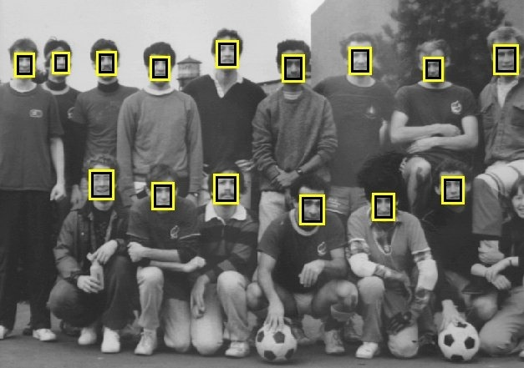
Problems
Object Detection

Slide 3
Problems
Object Detection: Many detection windows

Slide 4
Problems
Object Detection: Many detection windows

Slide 5
Problems
Object Detection: Many detection windows

Slide 6
Problems
Object Detection: Each window is very high dimension data
256x256
65536-d
10x10
100-d

Slide 7
Processing Methods
General framework
Very High dimensional
Raw Data
Classifier
Feature extraction
Dimensionality Reduction

Slide 8
Feature extraction/Dimensionality reduction
It is impossible to processing raw image data (pixels) directly
  Too many of them (or data dimensionality too high)
  Curse of dimensionality problem
Process the raw pixel to produce a smaller set of numbers which will capture most information contained in the original data – this is often called a feature vector

Slide 9
Feature extraction/Dimensionality reduction
Basic Principle
  From a raw data (vector) X of N-dimension to a new vector Y of n-dimensional (n < < N) via a transformation matrix A such that Y will capture most information in X

Slide 10
PCA
Principal Component Analysis (PCA) is one of the most often used dimensionality reduction technique.

Slide 11
PCA Goal
We wish to explain/summarize the underlying variance-covariance structure of a large set of variables through a few linear combinations of these variables.

Slide 12
Applications
  Data Visualization
  Data Reduction
  Data Classification
  Trend Analysis
  Factor Analysis
  Noise Reduction

Slide 13
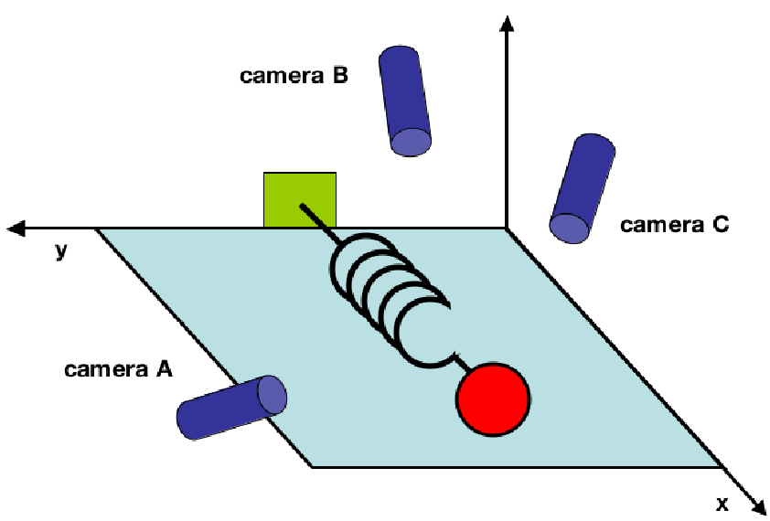
An example
A toy example: The movement of an ideal spring, the underlying dynamics can be expressed as a function of a single variable x.

Slide 14

An example
But, pretend that we are ignorant of that and
Using 3 cameras, each records 2d projection of the ball’s position. We record the data for 2 minutes at 200Hz
We have 12,000, 6-d data
How can we work out the dynamic is only along the x-axis
Thus determining that only the dynamics along x are important and the rest are redundant.

Slide 15
An example

Slide 16
An example
1st Eigenvector of the Covariance matrix
2nd Eigenvector of the Covariance matrix
6th Eigenvector of the Covariance matrix

Slide 17
An example
1st Eigenvector of the Covariance matrix
2nd Eigenvector of the Covariance matrix
1st Principal Component
2nd Principal Component
6th Eigenvector of the Covariance matrix

Slide 18
PCA
1st Eigenvector of the Covariance matrix
2nd Eigenvector of the Covariance matrix
Dynamic of the spring
6th Eigenvector of the Covariance matrix

Slide 19
PCA
1st Eigenvector of the Covariance matrix
2nd Eigenvector of the Covariance matrix
Dynamic of the spring
They contain no useful information and can be discarded!
6th Eigenvector of the Covariance matrix

Slide 20
PCA
We only need ONE number
Dynamic of the spring
Instead of
SIX
Numbers!

Slide 21
PCA
Linear combination (scaling) of ONE variable
Capture the data patterns of SIX
Numbers!

Slide 22
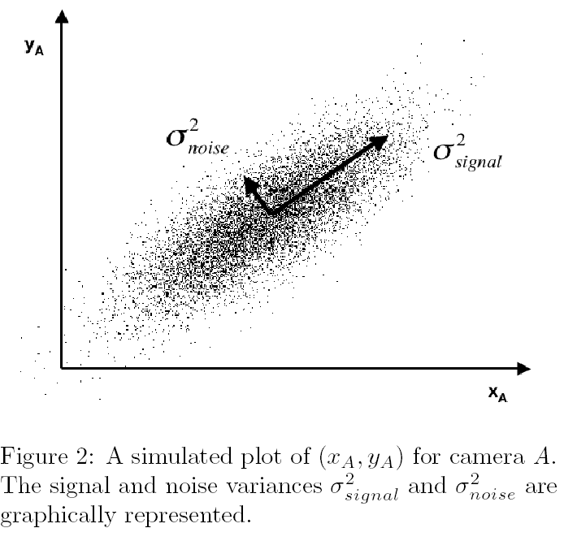
Noise

Slide 23
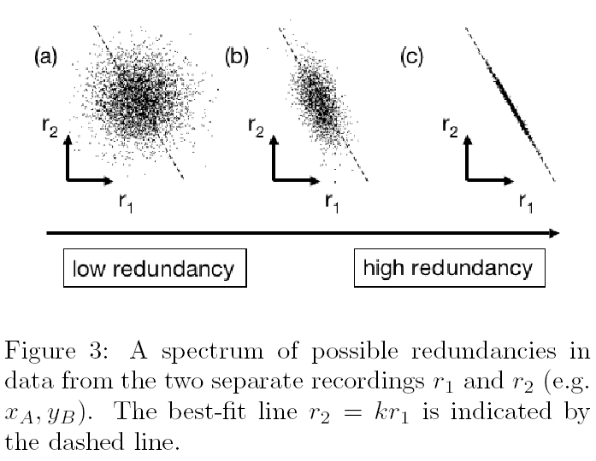
Redundancy
r1 and r2 entirely uncorrelated,
No redundancy in the two recordings
r1 and r2 strongly correlated,
high redundancy in the two recordings

Slide 24
Covariance matrix
One of the measurements of ALL samples (n samples)
One sample (m-d)

Slide 25
Covariance matrix
is the covariance matrix of the data

Slide 26
Covariance matrix
S_{x} is an m x m square matrix, m is the dimensionality of the measures (feature vectors)
The diagonal terms of S_{x} are the variance of particular measurement type
The off-diagonal terms of S_{x} are the covariance between measurement types

Slide 27
Covariance matrix
S_{x} is special.
It describes all relationships between pairs of measurements in our data set.
A larger covariance indicates large correlation (more redundancy), zero covariance indicates entirely uncorrelated data.

Slide 28
Covariance matrix
Diagonalise the covariance matrix
If our goal is to reduce redundancy, then we want each variable co-vary a little as possible
Precisely, we want the covariance between separate measurements to be zero

Slide 29
Feature extraction/Dimensionality reduction
Remove redundancy
Optimal covariance matrix S_{Y} - off-diagonal terms set zero
Therefore removing redundancy, diagonalises S_{Y}

Slide 30
Feature extraction/Dimensionality reduction
How to find the transformation matrix
Remove redundancy
Optimal covariance matrix S_{Y} - off-diagonal terms set zero
Therefore removing redundancy, diagonalises S_{Y}

Slide 31
Solving PCA: Diagonalising the Covariance Matrix
There are many ways to diagonalizing S_{Y}, PCA choose the simplest method.
PCA assumes all basis vectors are orthonormal. P is an orthonormal matrix
PCA assumes the directions with the largest variances are the most important or most principal.

Slide 32
Solving PCA: Diagonalising the Covariance Matrix
PCA works as follows
  PCA first selects a normalised direction in m-dimensional space along which the variance of X is maximised – it saves the direction as p₁
  It then finds another direction, along which variance is maximised subject to the orthonormal condition – it restricts its search to all directions perpendicular to all previous selected directions.
  The process could continue until m directions are found. The resulting ORDERED set of p’s are the principal components
  The variances associated with each direction p_{i} quantify how principal (important) each direction is – thus rank-ordering each basis according to the corresponding variance

Slide 33
2nd Principal
Component, y₂
1st Principal
Component, y₁

Slide 34
Solving PCA Eigenvectors of Covariance
Find some orthonormal matrix P such that S_{Y} is diagonalized.
The row of P are the principal components of X

Slide 35
Solving PCA Eigenvectors of Covariance
A is a symmetric matrix, which can be diagonalised by an orthonormal matrix of its eigenvectors.

Slide 36
Solving PCA Eigenvectors of Covariance
D is a diagonal matrix, E is a matrix of eigenvectors of A arranged as columns
The matrix A has r < = m orthonormal eigenvectors, where r is the rank of A.
r is less than m when A is degenerate or all data occupy a subspace of dimension r < m

Slide 37
Solving PCA Eigenvectors of Covariance
Select the matrix P to be a matrix where each row p_{i} is an eigenvector of XX^{T}.

Slide 38
Solving PCA Eigenvectors of Covariance
The principal component of X are the eigenvectors of XX^{T}; or the rows of P
The ith diagonal value of S_{Y} is the variance of X along p_{i}

Slide 39
PCA Procedures
Get data (example)
Step 1
  Subtract the mean (example)
Step 2
  Calculate the covariance matrix
Step 3
  Calculate the eigenvectors and eigenvalues of the covariance matrix

Slide 40
A 2D Numerical Example

Slide 41
PCA Example – Data
Original data
x y
2.5 | 2.4
0.5 | 0.7
2.2 | 2.9
1.9 | 2.2
3.1 | 3
2.3 | 2.7
2 | 1.6
1 | 1.1
1.5 | 1.6
1.1 | 0.9

Slide 42
STEP 1
Subtract the mean
from each of the data dimensions. All the x values have average (x) subtracted and y values have average (y) subtracted from them. This produces a data set whose mean is zero.
Subtracting the mean makes variance and covariance calculation easier by simplifying their equations. The variance and co-variance values are not affected by the mean value.

Slide 43
STEP 1
Zero-mean data
0.69 | 0.49
-1.31 | -1.21
0.39 | 0.99
0.09 | 0.29
1.29 | 1.09
0.49 | 0.79
0.19 | -0.31
-0.81 | -0.81
-0.31 | -0.31
-0.71 | -1.01

Slide 44
STEP 1
Original
Zero-mean

Slide 45
STEP 2
Calculate the covariance matrix
cov = .616555556 .615444444
.615444444 .716555556
since the non-diagonal elements in this covariance matrix are positive, we should expect that both the x and y variable increase together.

Slide 46
STEP 3
Calculate the eigenvectors and eigenvalues of the covariance matrix
eigenvalues = .0490833989
1.28402771
eigenvectors = -.735178656 -.677873399
.677873399 -.735178656

Slide 47
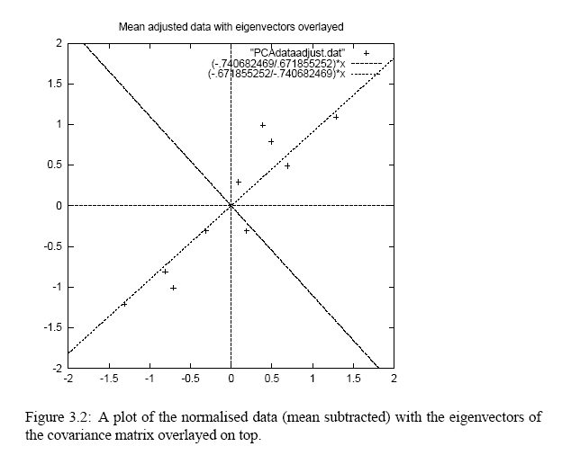
STEP 3
eigenvectors are plotted as diagonal dotted lines on the plot.
Note they are perpendicular to each other.
Note one of the eigenvectors goes through the middle of the points, like drawing a line of best fit.
The second eigenvector gives us the other, less important, pattern in the data, that all the points follow the main line, but are off to the side of the main line by some amount.

Slide 48
Feature Extraction
Reduce dimensionality and form feature vector
  the eigenvector with the highest eigenvalue is the principal component of the data set.
  In our example, the eigenvector with the larges eigenvalue was the one that pointed down the middle of the data.
  Once eigenvectors are found from the covariance matrix, the next step is to order them by eigenvalue, highest to lowest. This gives you the components in order of significance.

Slide 49
Feature Extraction
Eigen Feature Vector
FeatureVector = (eig₁ eig₂ eig₃ … eig_{n})
We can either form a feature vector with both of the eigenvectors:
-.677873399 -.735178656
-.735178656 .677873399
or, we can choose to leave out the smaller, less significant component and only have a single column:
- .677873399
- .735178656

Slide 50
Eigen-analysis/ Karhunen Loeve Transform
Eigen Matrix

Slide 51
Eigen-analysis/ Karhunen Loeve Transform
Back to our example: Transform data to eigen-space (x’ , y’)
x’ = -0.68x - 0.74y y’ = -0.74x + 0.68y
-.827970186 -.175115307
1.77758033 .142857227
-.992197494 .384374989
-.274210416 .130417207
-1.67580142 -.209498461
-.912949103 .175282444
.0991094375 -.349824698
1.14457216 .0464172582
.438046137 .0177646297
1.22382056 -.162675287
x y
0.69 | 0.49
-1.31 | -1.21
0.39 | 0.99
0.09 | 0.29
1.29 | 1.09
0.49 | 0.79
0.19 | -0.31
-0.81 | -0.81
-0.31 | -0.31
-0.71 | -1.01

Slide 52
Eigen-analysis/ Karhunen Loeve Transform
y’
x’
y
x

Slide 53
Reconstruction of original Data/Inverse Transformation
Forward Transform
Inverse Transform

Slide 54
Reconstruction of original Data/Inverse Transformation
If we reduced the dimensionality, obviously, when reconstructing the data we would lose those dimensions we chose to discard.
Thrown away the less important one, throw away y’ and only keep x’

Slide 55
Reconstruction of original Data/Inverse Transformation
x’
-.827970186
1.77758033
-.992197494
-.274210416
-1.67580142
-.912949103
.0991094375
1.14457216
.438046137
1.22382056
y_{reconstruction}
x_{reconstruction}

Slide 56
Reconstruction of original Data
Reconstructed from 1 eigen feature
Original data
y
x
y_{reconstruction}
x_{reconstruction}

Slide 57
Feature Extraction/Eigen-features
Eigen Feature vector

Slide 58
PCA Applications –General
1st eigenvector
Data compression/dimensionality reduction
m^{th} eigenvector

Slide 59
PCA Applications -General
Data compression/dimensionality reduction

Slide 60
PCA Applications -General
Data compression/dimensionality reduction
Reduce the number of features needed for effective data representation by discarding those features having small variances
The most interesting dynamics occur only in the first l dimensions (l << m).

Slide 61
PCA Applications -General
We know what can be thrown away; or do we?
Data compression/dimensionality reduction
Reduce the number of features needed for effective data representation by discarding those features having small variances
The most interesting dynamics occur only in the first l dimensions (l << m).

Slide 62
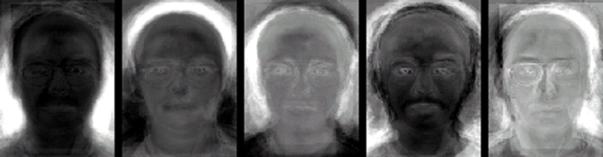
Eigenface Example
A 256x256 face image, 65536 dimensional vector, X, representing the face images with much lower dimensional vectors for analysis and recognition
  Compute the covariance matrix, find its eigenvector and eigenvalue
  Throw away eigenvectors corresponding to small eigenvalues, and keep the first l (l << m) principal components (eigenvectors)
p₁
p₂
p₃
p₄
p₅

Slide 63
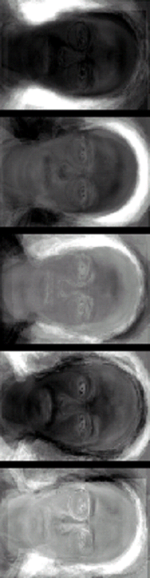

Eigenface Example
A 256x256 face image, 65536 dimensional vector, X, representing the face images with much lower dimensional vectors for analysis and recognition
Instead of
65536
Numbers!
We now only use
FIVE
Numbers!

Slide 64
Eigen Analysis - General
  The same principle can be applied to the analysis of many other data types
Raw data representation
Reduce the dimensionality of biomarkers for analysis and classification

Slide 65
Processing Methods
General framework
PCA/Eigen Analysis
Very High dimensional
Raw Data
Classifier
Feature extraction
Dimensionality Reduction

Slide 66
PCA
Some remarks about PCA
  PCA computes projection directions in which variances of the data can be ranked
  The first few principal components capture the most “energy” or largest variance of the data
  In classification/recognition tasks, which principal component is more discriminative is unknown

Slide 67
PCA
Some remarks about PCA
  Traditional popular practice is to use the first few principal components to represent the original data.
  However, the subspace spanned by the first few principal components is not necessarily the most discriminative.
  Therefore, throwing away the principal components with small variances may not be a good idea!

